Slide 1
























DEPARTMENT OF
CIVIL AND ENVIRONMENTAL
ENGINEERING

Slide 2








THEMATIC DIVISIONS
WATER SCIENCE AND ENGINEERING
HYDRAULIC ENGINEERING
STRUCTURES AND ENVIRONMENT
CIVIL AND
ENVIRONMENTAL
ENGINEERING
MECHANICS OF MATERIALS AND STRUCTURES
TRANSPORT INFRASTRUCTURES AND GEOSCIENCES
GEODESY AND GEOMATICS
STRUCTURAL DESIGN, DIAGNOSTICS AND REHABILITATION
ENVIRONMENTAL ENGINEERING

Slide 3
People @DICA

Slide 4

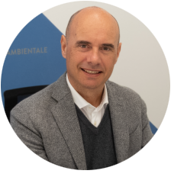
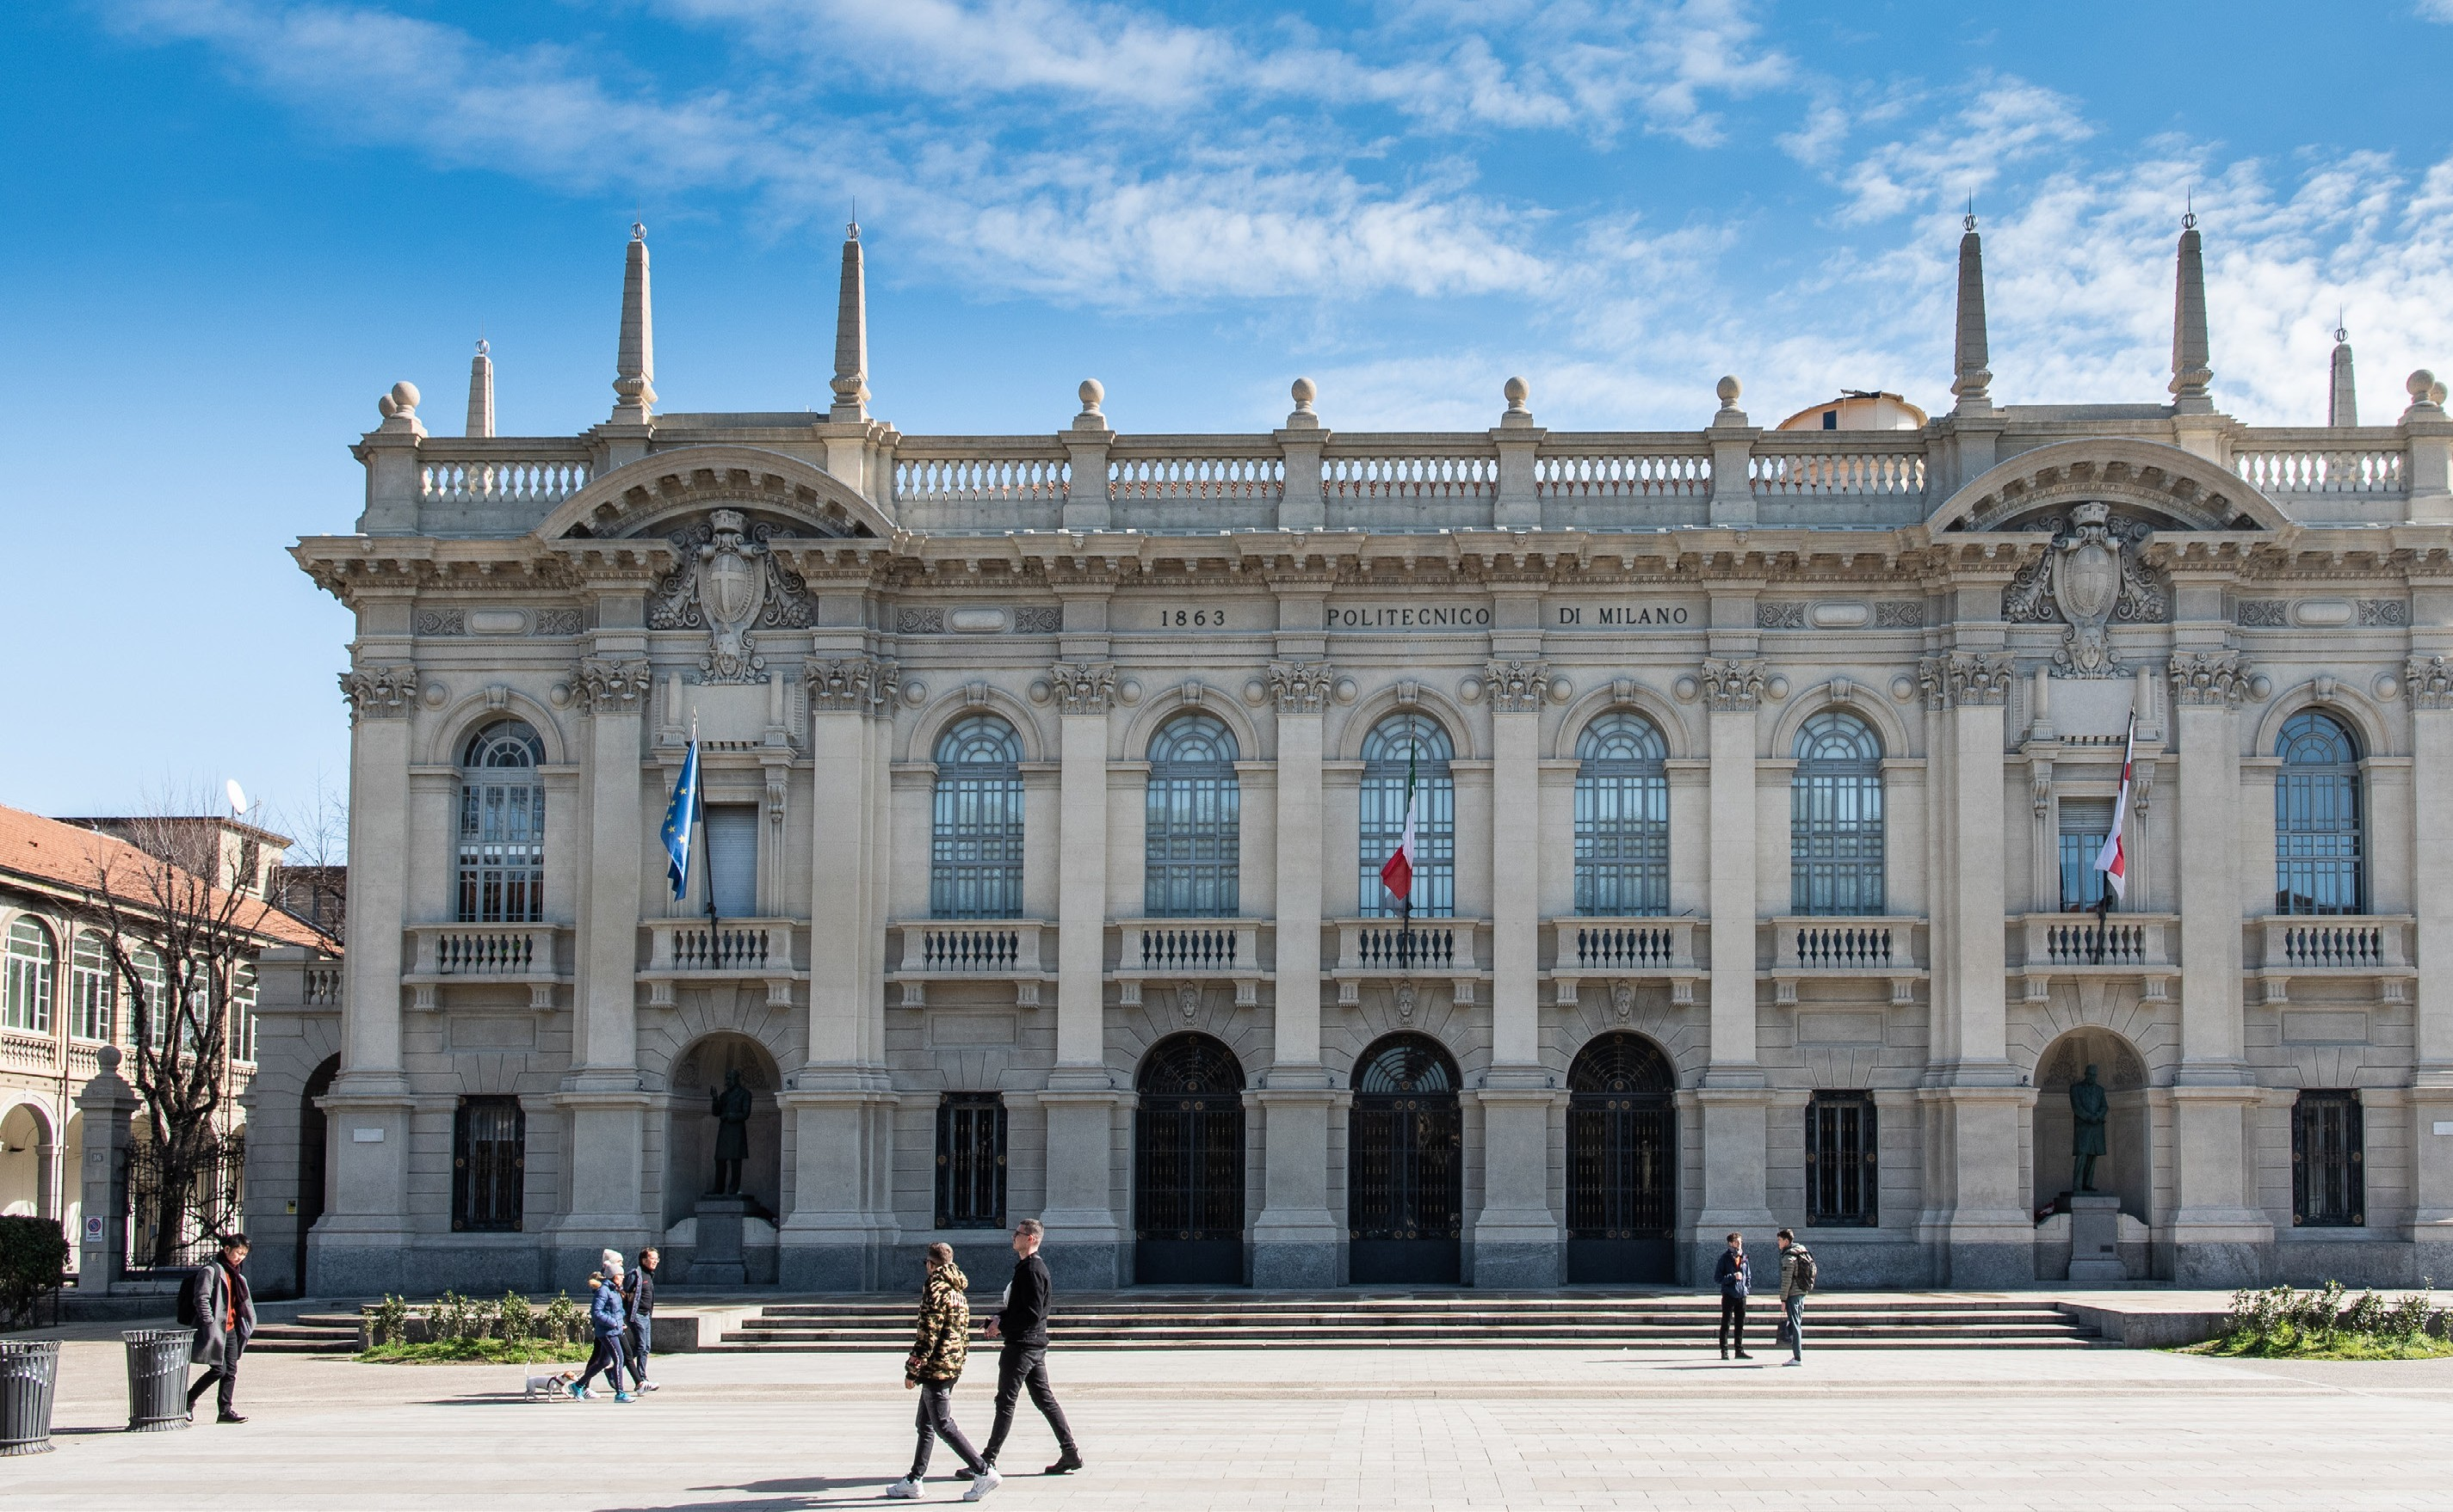
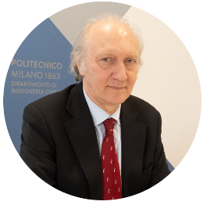
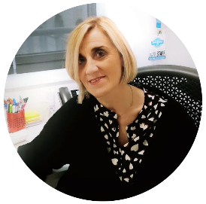





PROF. ATTILIO FRANGI
Department Head
PROF. RICCARDO BARZAGHI
Deputy Head
DOTT.SSA DANIELA FAGNANI
Management Responsible
123
117
190
40
PROFESSORS
AND RESEARCHERS
February 2025
RESEARCH
FELLOWS
February 2025
TECHNICAL
ADMINISTRATIVE STAFF
February 2025
PhDs
February 2025

Slide 5
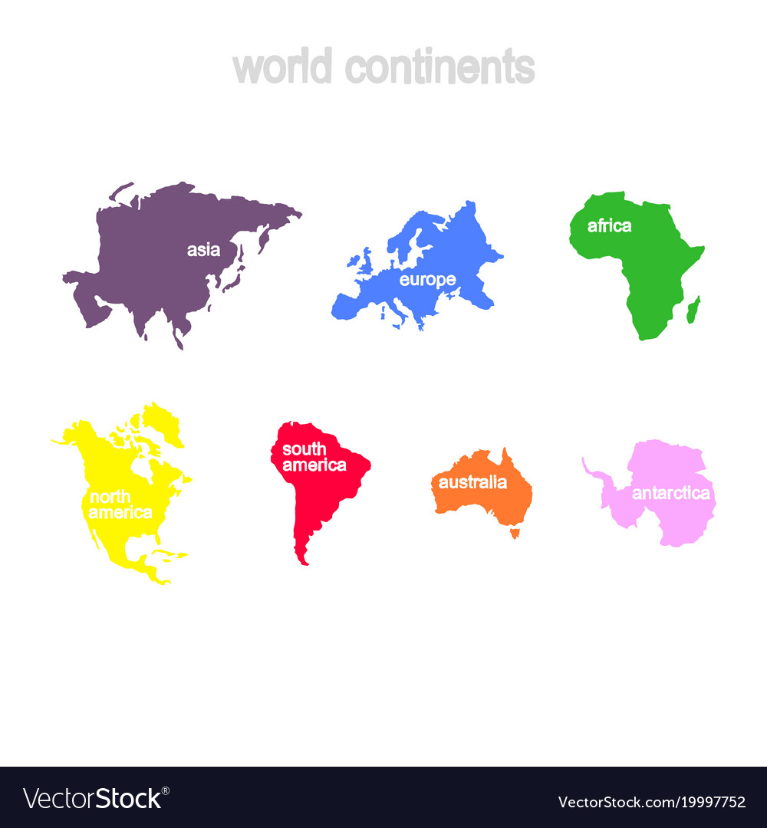















VISITING @ DICA
GEOGRAPHICAL DISTRIBUTION OF ARRIVALS BY CATEGORY PERIOD (July 1 - November 30, 2024), AND COMPARISON WITH THE SAME PERIOD IN 2023 AND 2022.
The nationality of visiting scholars is considered as the reference data for determining their origin.
CATEGORIES
EU
China
Iran
Pakistan
Algeria
31
2024
10 - 32%
15 – 49%
1 – 3%
1 – 3%
3 – 10%
20
2023
2 – 16,6%
13 – 65%
2 – 16,6%
2 – 10%
12
2022
2– 16,6%
4 – 33,3%
1 – 5,6%
1 – 8,4%
PhD visiting
USA
Brasile
2024
0 – 0%
1 – 3%
2023
1 – 5%
1 – 5%
2022
EU
China
Kazakistan
Turchia
Giappone
Algeria
Canada
17
6 – 35%
3 – 18% 3 – 18% 2 – 12%
2 - 12%
1 –6%
2 – 25%
2024
Professors
& Researchers
10
2023
2 – 25%
2 – 25% 2 – 25%
8
2022
5 – 62,5%
1 – 12,5%
EU
Turchia
1
2024
0 – 0%
1 – 100%

Slide 6
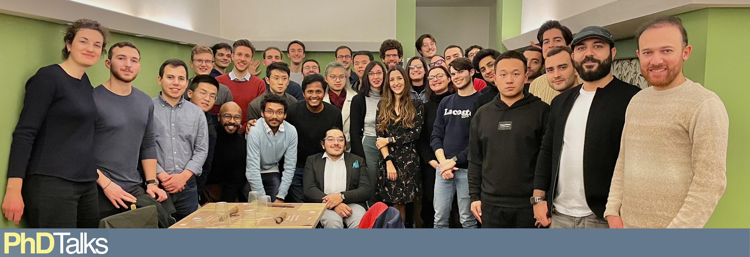
INCLUSIVE ENVIRONMENT - PhDTalks

Slide 7

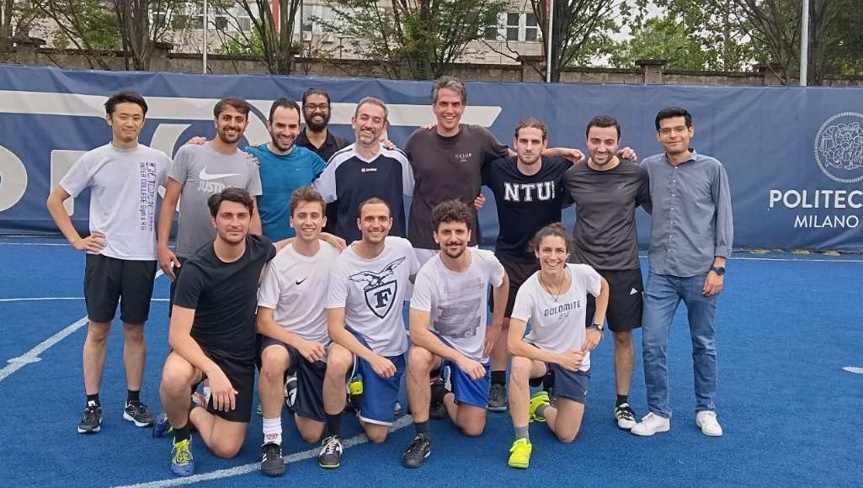
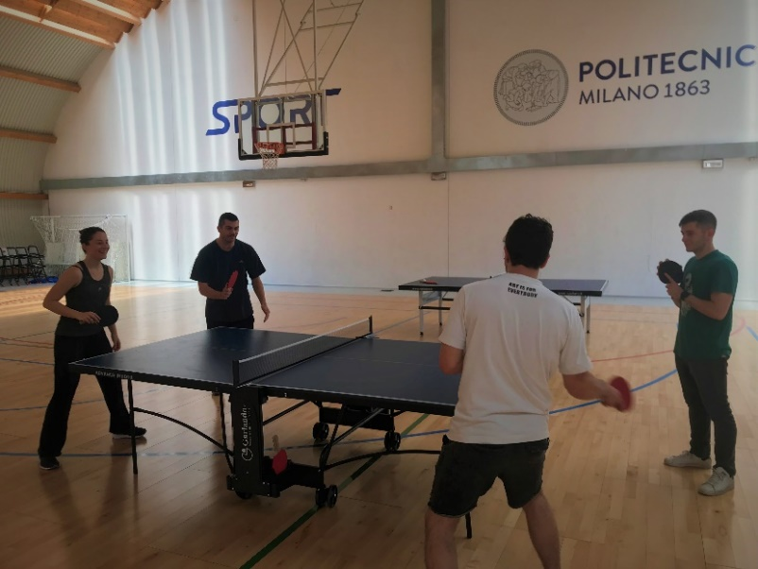
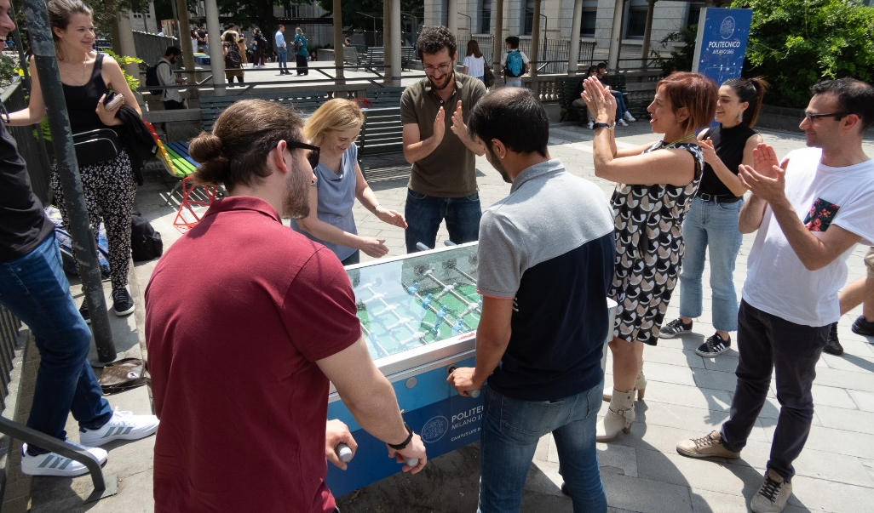
INCLUSIVE ENVIRONMENT – DICA Olympic Games

Slide 8
Teaching @DICA

Slide 9
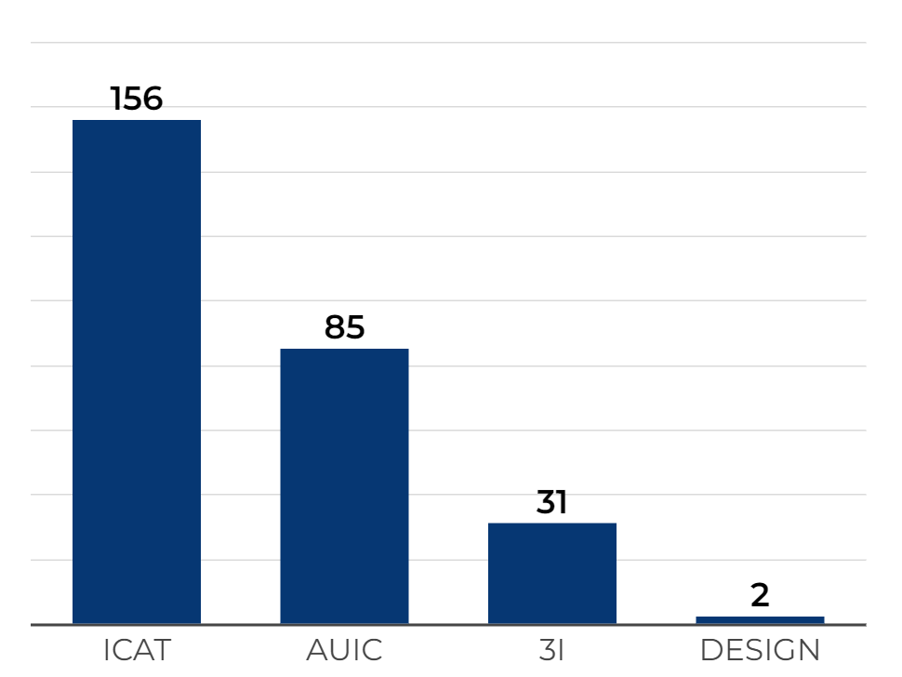
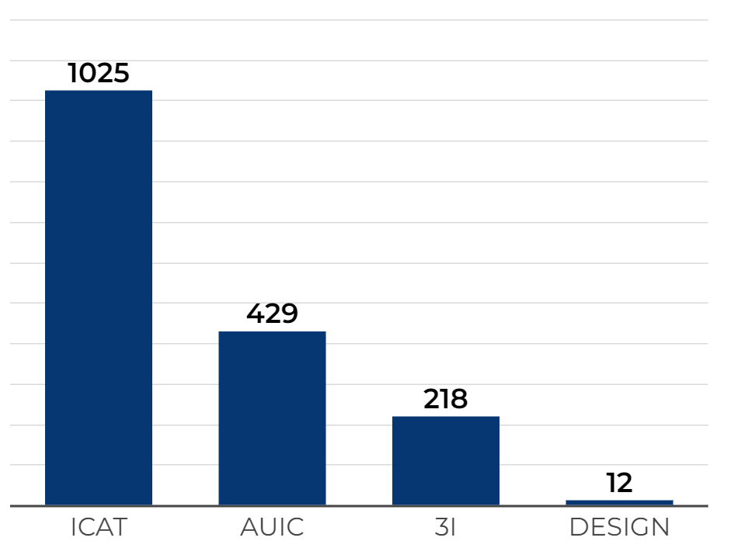
COURSES OFFERED
COURSES – 274 TOTAL
CFU – 1684 TOTAL
transversality of disciplines
major focus on ICAT and AUIC
Strongly supporting ICAT to maximise the appeal of Civil and Environmental Engineering and favour the enrollment of new students

Slide 10
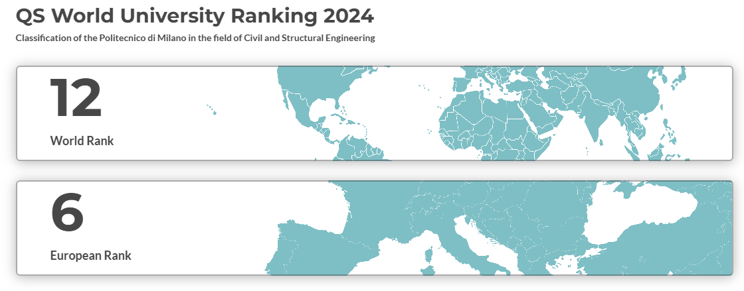
Civil and Structural Engineering @Polimi
Research @DICA

Slide 11

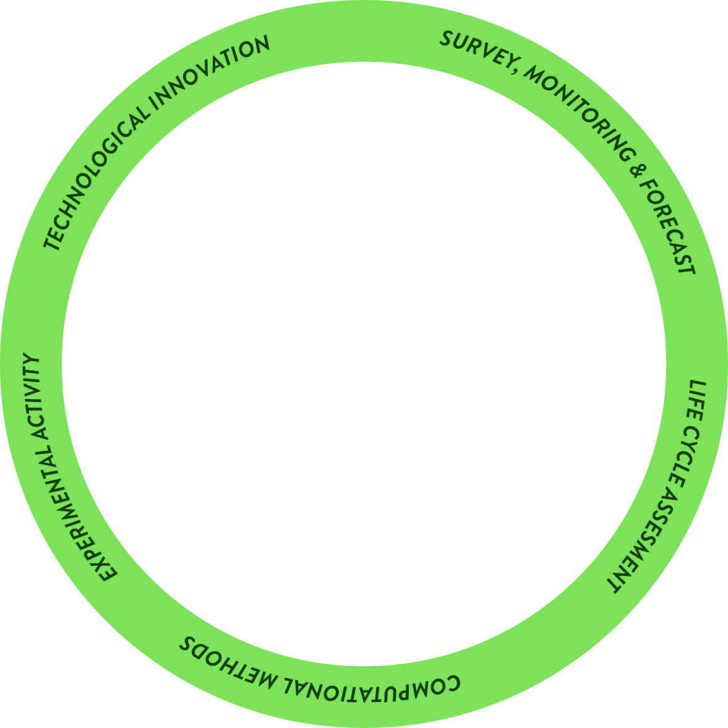
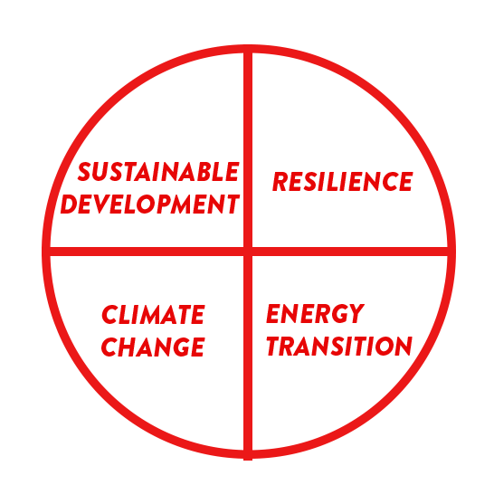
landslides
drought
earthquakes
sensors
buildings
SMART CITIES
NATURAL RISKS
digital twins
EWS
floods
BIM
fire & blast
Citizen Science
recycling & reuse
FOOD
WASTE MANAGEMENT
Agriculture 4.0
remediation
durability & performance
hydrogen storage
POLLUTION
ADVANCED MATERIALS
carbon capture
toughness
3D printing
structural & energy retrofitting
smart functionalities
GNSS
CULTURAL HERITAGE
GIS
EARTH OBSERVATION
bridges
UAV
tunnels & underground structures
resources
energy harvesting
groundwater
dams
WATER
INFRASTRUCTURES
renewable energy
offshore structures
water networks
reservoirs
roads & airports

Slide 12
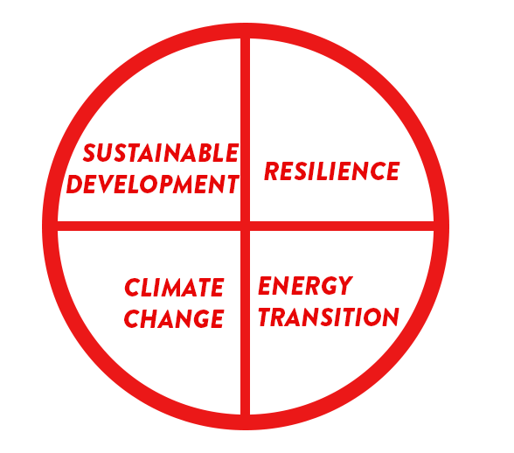

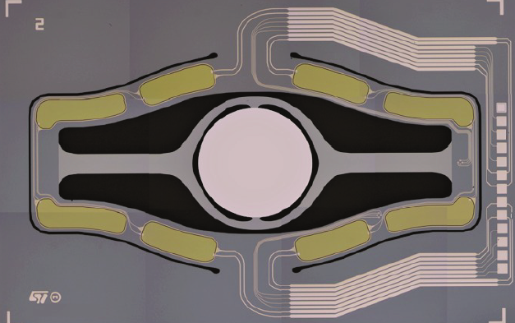
landslides
drought
earthquakes
sensors
buildings
SMART CITIES
NATURAL RISKS
digital twins
EWS
floods
BIM
fire & blast
Citizen Science
recycling & reuse
FOOD
WASTE MANAGEMENT
Agriculture 4.0
remediation
durability & performace
hydrogen storage
POLLUTION
ADVANCED MATERIALS
carbon capture
toughness
3D printing
structural & energy retrofitting
smart functionalities
500 μm
CULTURAL HERITAGE
GIS
EARTH OBSERVATION
bridges
GNSS
UAV
MICROSYSTEMS
mirror for augmented reality
EARTH OBSERVATION
tunnels & underground structures
resources
energy harvesting
groundwater
dams
WATER
INFRASTRUCTURES
renewable energy
offshore structures
water networks
reservoirs
roads & airports

Slide 13
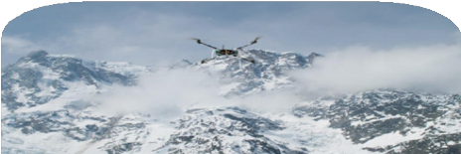
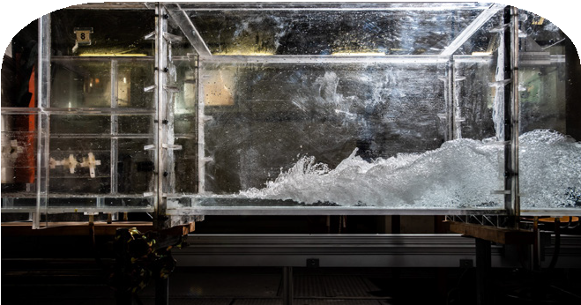
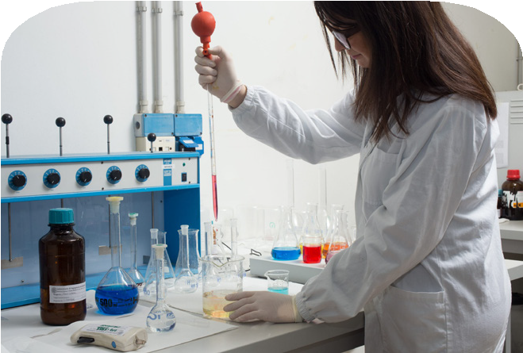
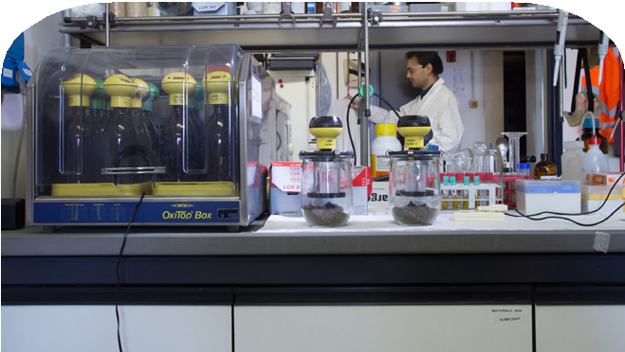
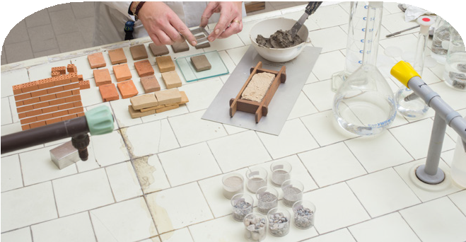
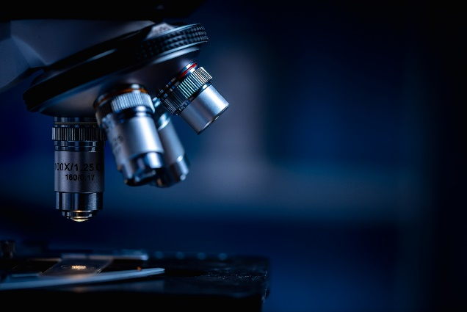
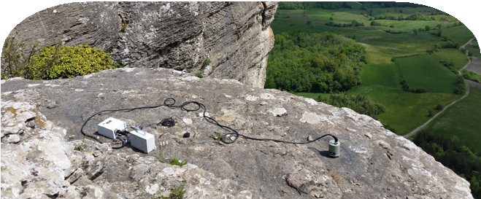
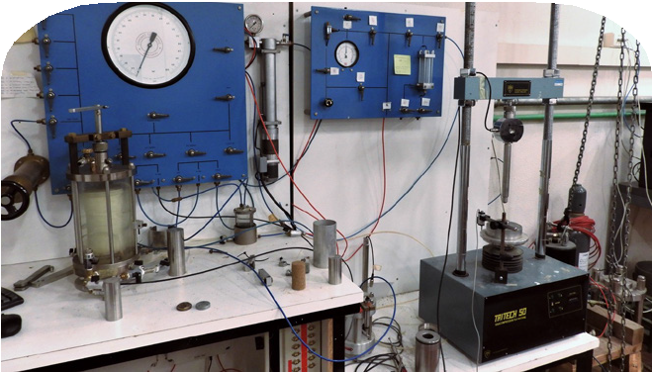

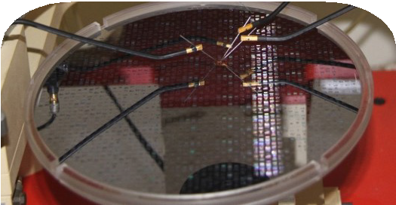
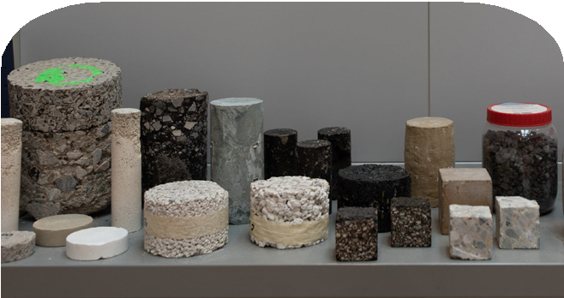
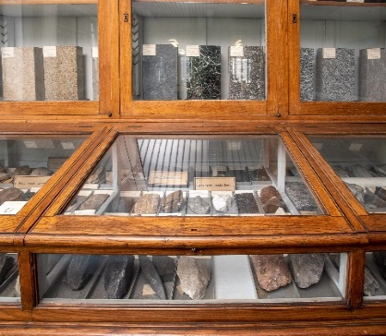
LABORATORY FACILITIES
GEODETIC AND PHOTOGRAMMETRIC MEASUREMENTS LABORATORY (LABMGF)
HYDRAULICS LABORATORY “GAUDENZIO FANTOLI” (LIF)
ENVIRONMENTAL ENGINEERING LABORATORIES
(LIA lab)
ENVIRONMENTAL ENGINEERING LABORATORIES
(FabE-lab)
DIAGNOSTIC AND INVESTIGATION LABORATORY ON BUILDING MATERIALS
SOLID-LIQUID INTERFACE NANOMICROSCOPY & SPECTROSCOPY LAB
(SOLINANO-Σ LAB)
GEOTECHNICAL MATERIALS, PROCESSES AND MODELS LABORATORY
LABORATORY OF COMPUTATIONAL MECHANICS
(LabMecC)
LABORATORY OF MEMS, MICROMECHANICS AND FULL FIELD MEASUREMENTS
(M3 LAB)
RESEARCH LABORATORY ON TRANSPORTATION INFRASTRUCTURES (INFRALAB)
LABORATORY OF APPLIED GEOPHYSICS MEASUREMENTS
PETROGRAPHIC COLLECTION

Slide 14






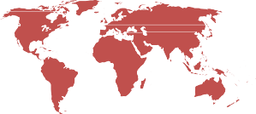




RESEARCH PROJECTS
(2016-2025)
National projects
Some examples:
35
H2020-HE
Other EU projects
Interreg projects
International
projects
23
201
6
3

Slide 15
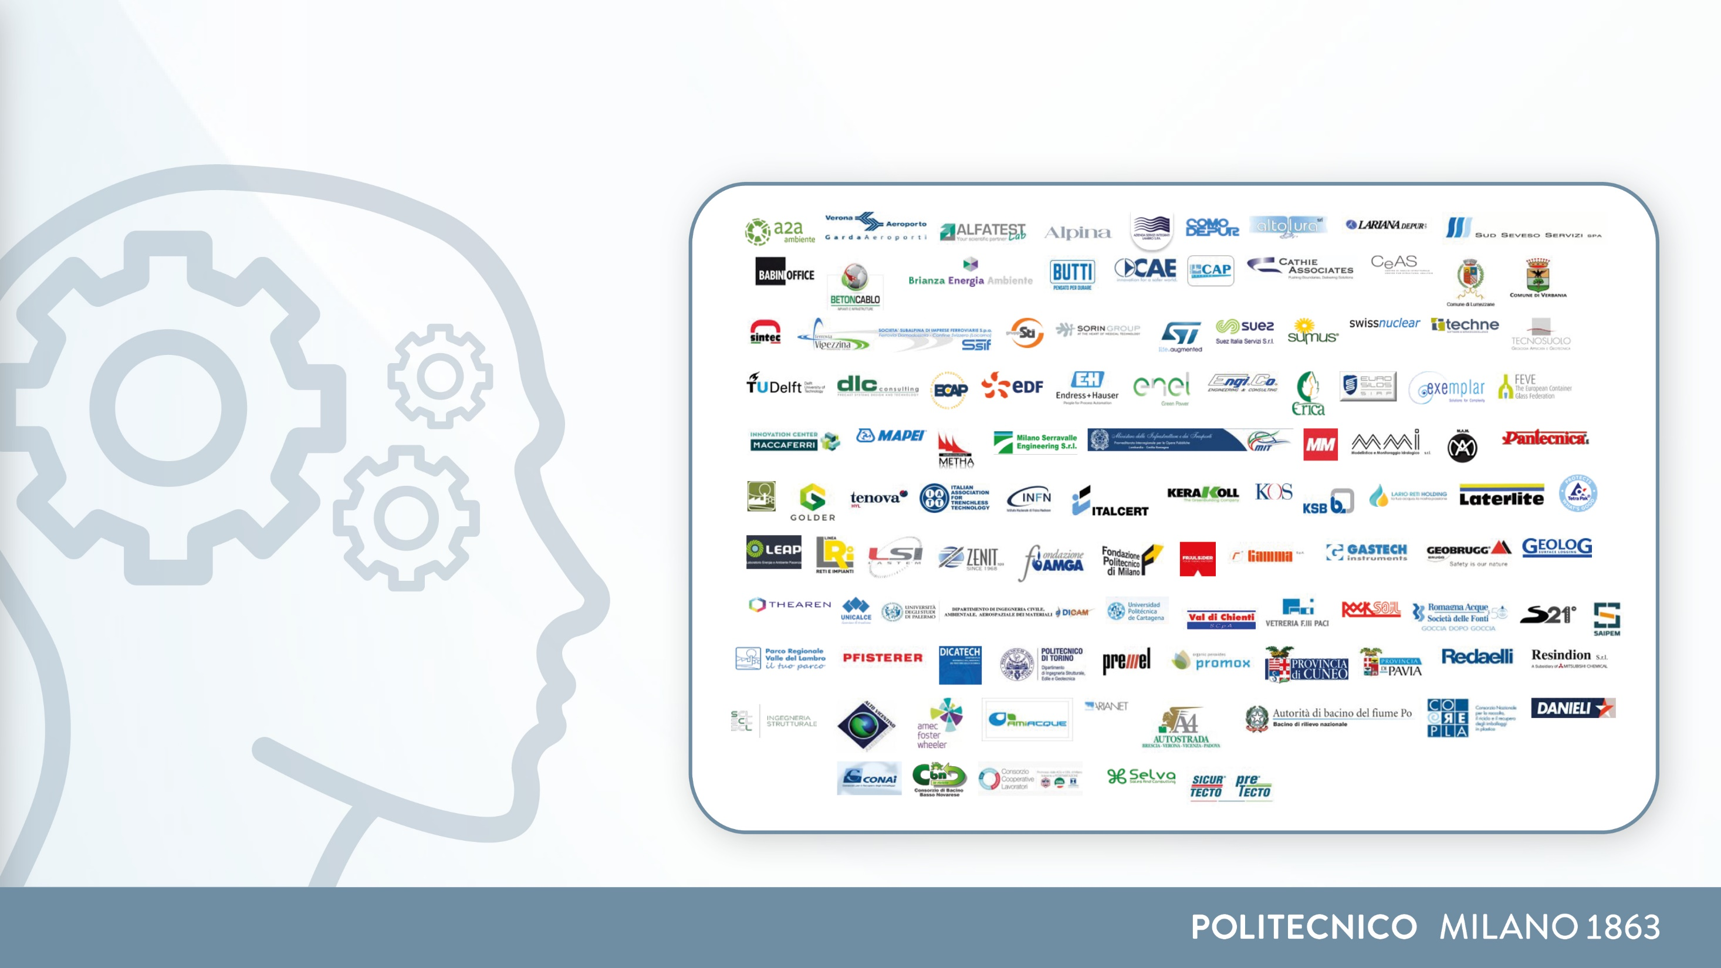
RESEARCH CONTRACTS 2024
Nr. 104 research actuating contracts
OUR PARTNERS

Slide 16
PhD PROGRAMS
DEPARTMENT OF CIVIL AND ENVIRONMENTAL ENGINEERING
(IAI – 100 PhDs)
ENVIRONMENTAL AND
INFRASTRUCTURE ENGINEERING
(ISSG – 90 PhDs)
STRUCTURAL, SEISMIC AND GEOTECHNICAL ENGINEERING
190
PhDs
February 2025

Slide 17
Social Responsibility @DICA

Slide 18
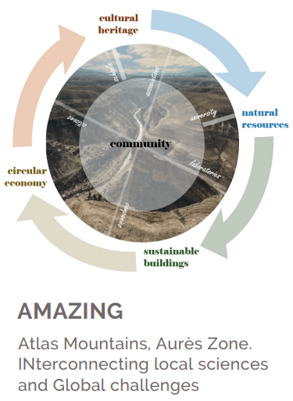
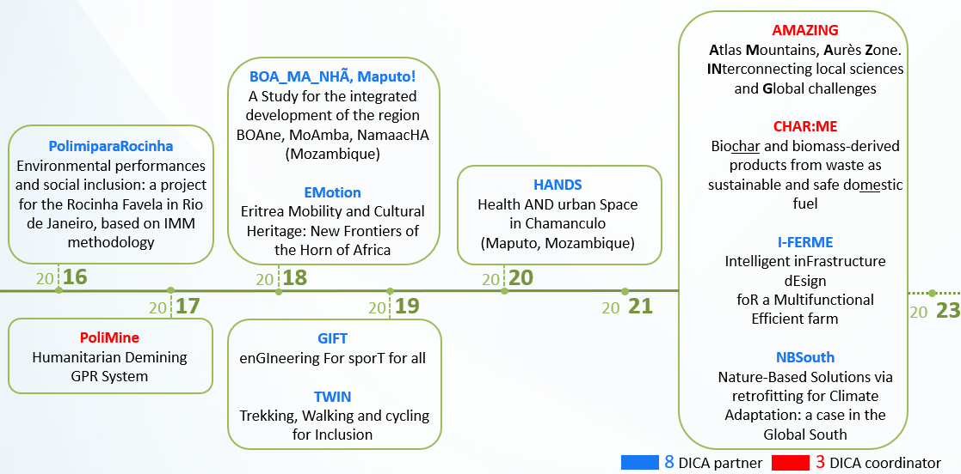
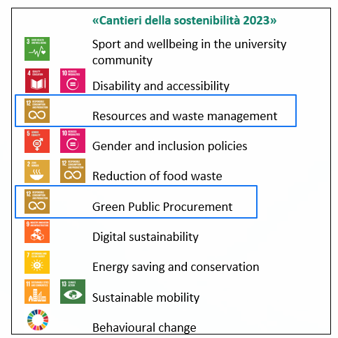
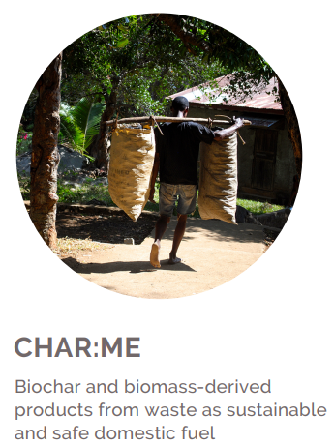
INVOLVEMENT IN POLIMI PROJECTS
Polisocial

Slide 19

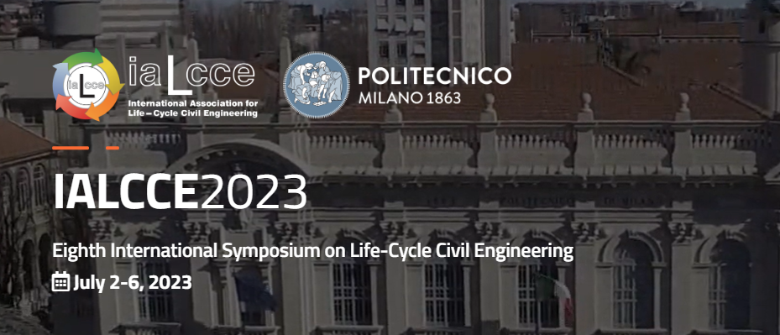
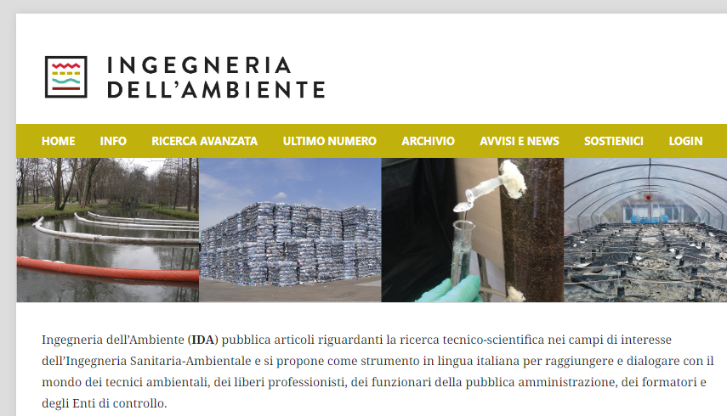
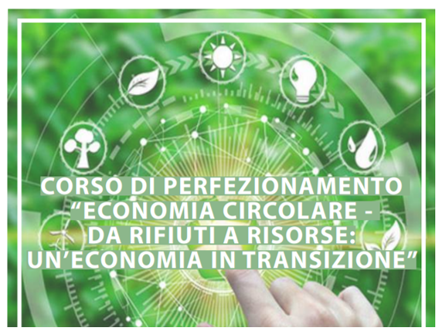

SCIENTIFIC DISSEMINATION
Organization of workshops and conferences
dedicated journals
continuing education

Slide 20


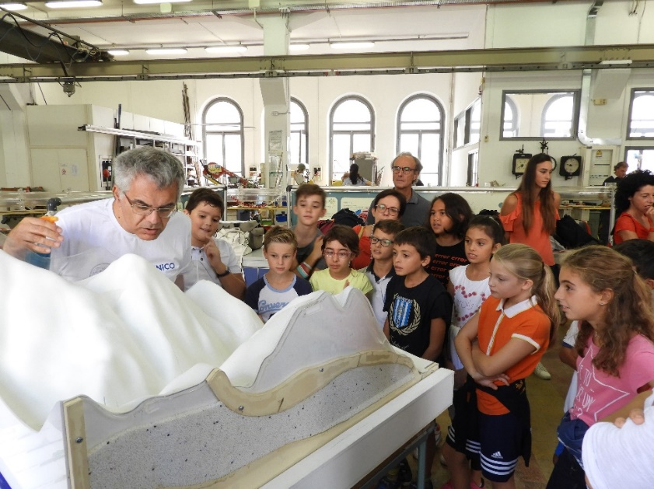
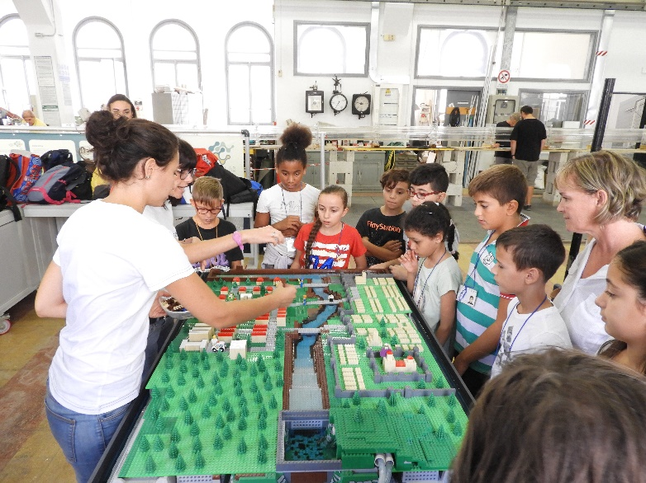

Born in 2017, the DICA4Schools project is a technical-scientific dissemination tool in schools, through the free offer of interactive laboratories and seminars
workshops held in the spaces of the Politecnico
seminars preferably organized in schools and dealing with topics of interest through open lessons and debates

