Slide 1





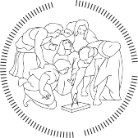


















DEPARTMENT OF
CIVIL AND ENVIRONMENTAL
ENGINEERING

Slide 2
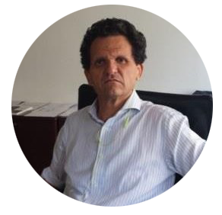
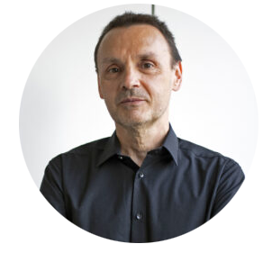
BRIEF HISTORY
Dipartimento di Ingegneria Idraulica, Ambientale, Infrastrutture viarie e Rilevamento​
(DIIAR)​
Dept. of Environmental, Hydraulic, Infrastructures and Surveying Engineering​
Dipartimento di Ingegneria Strutturale​
(DIS)​
Dept. of Structural Engineering
2013
Dipartimento di Ingegneria Civile e Ambientale​
(DICA)​
Department of Civil and Environmental Engineering
PROF. GIANPAOLO ROSATI
Department Head 2013-2016
PROF. ALBERTO GUADAGNINI
Department Head 2017-2022
CELEBRATING NOW THE 10TH ANNIVERSARY!

Slide 3
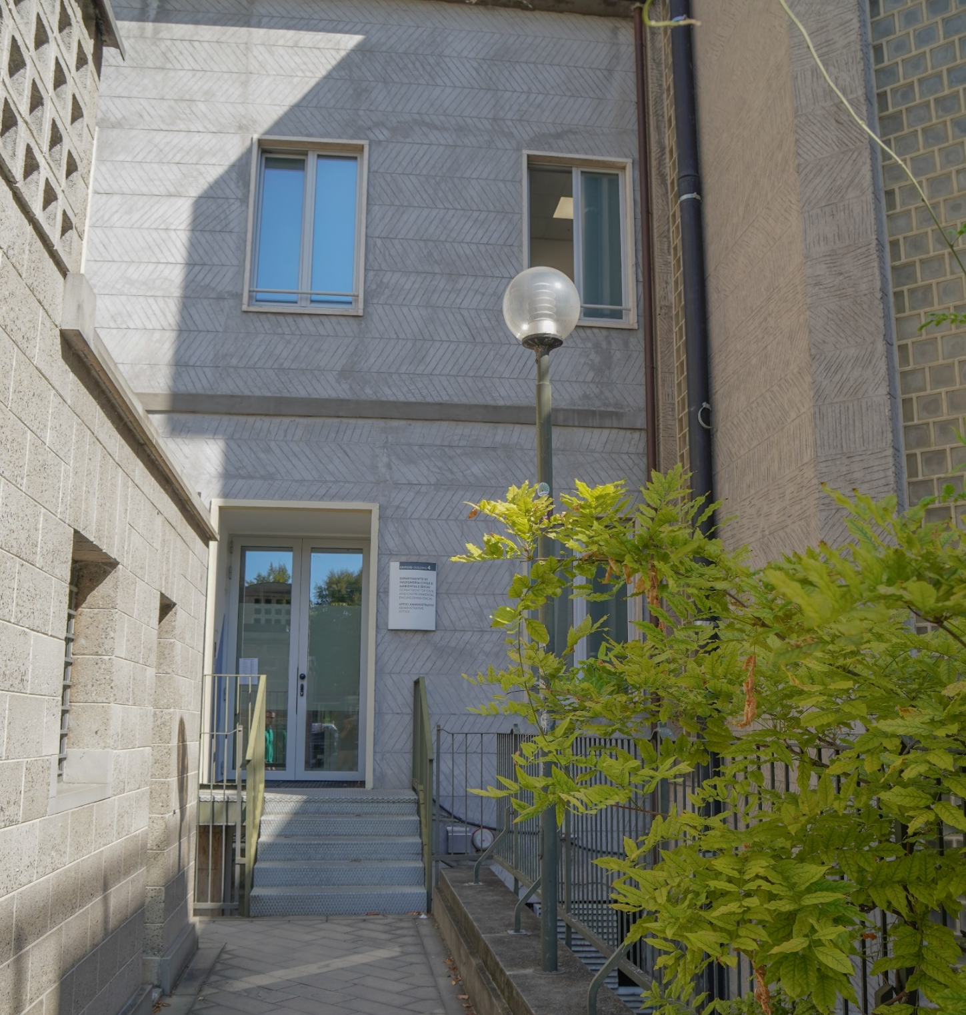
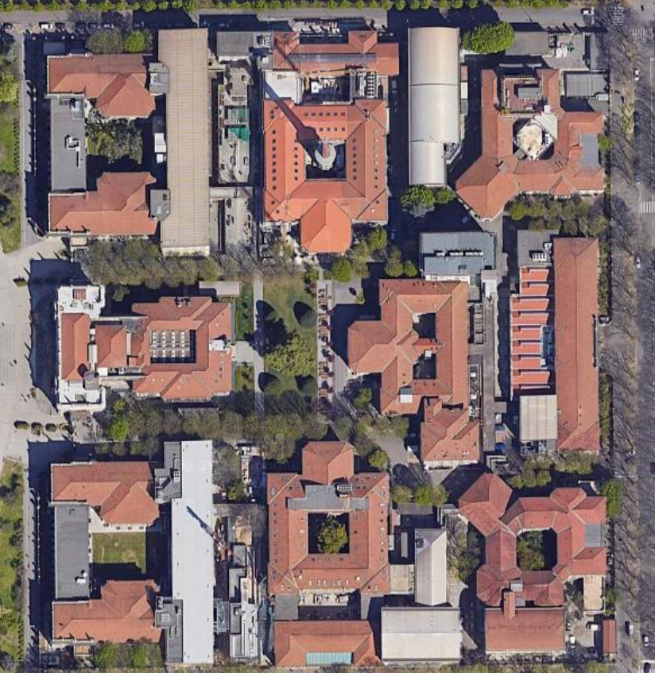

Building 4

Slide 4
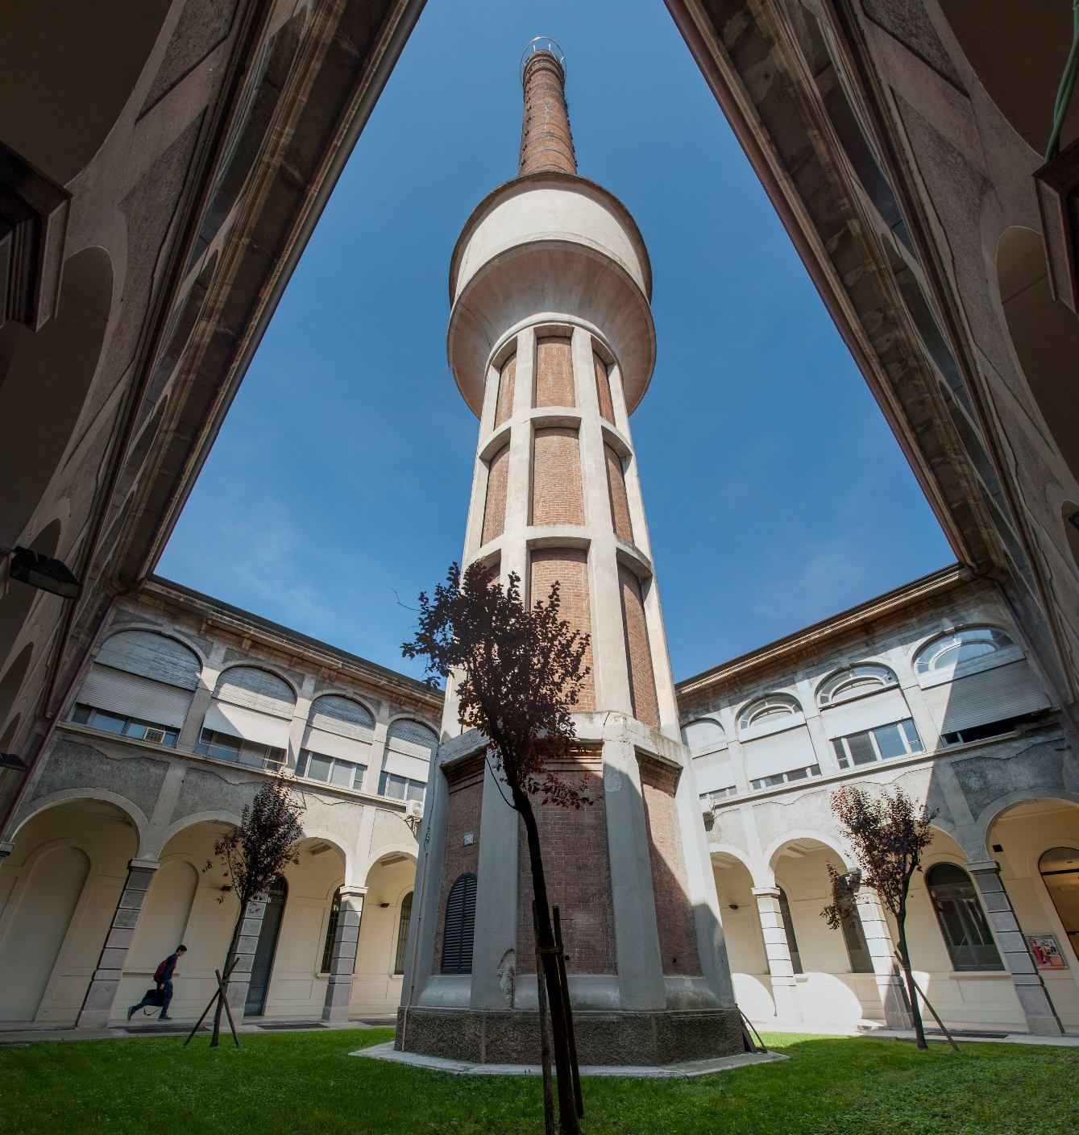

Building 4

Slide 5
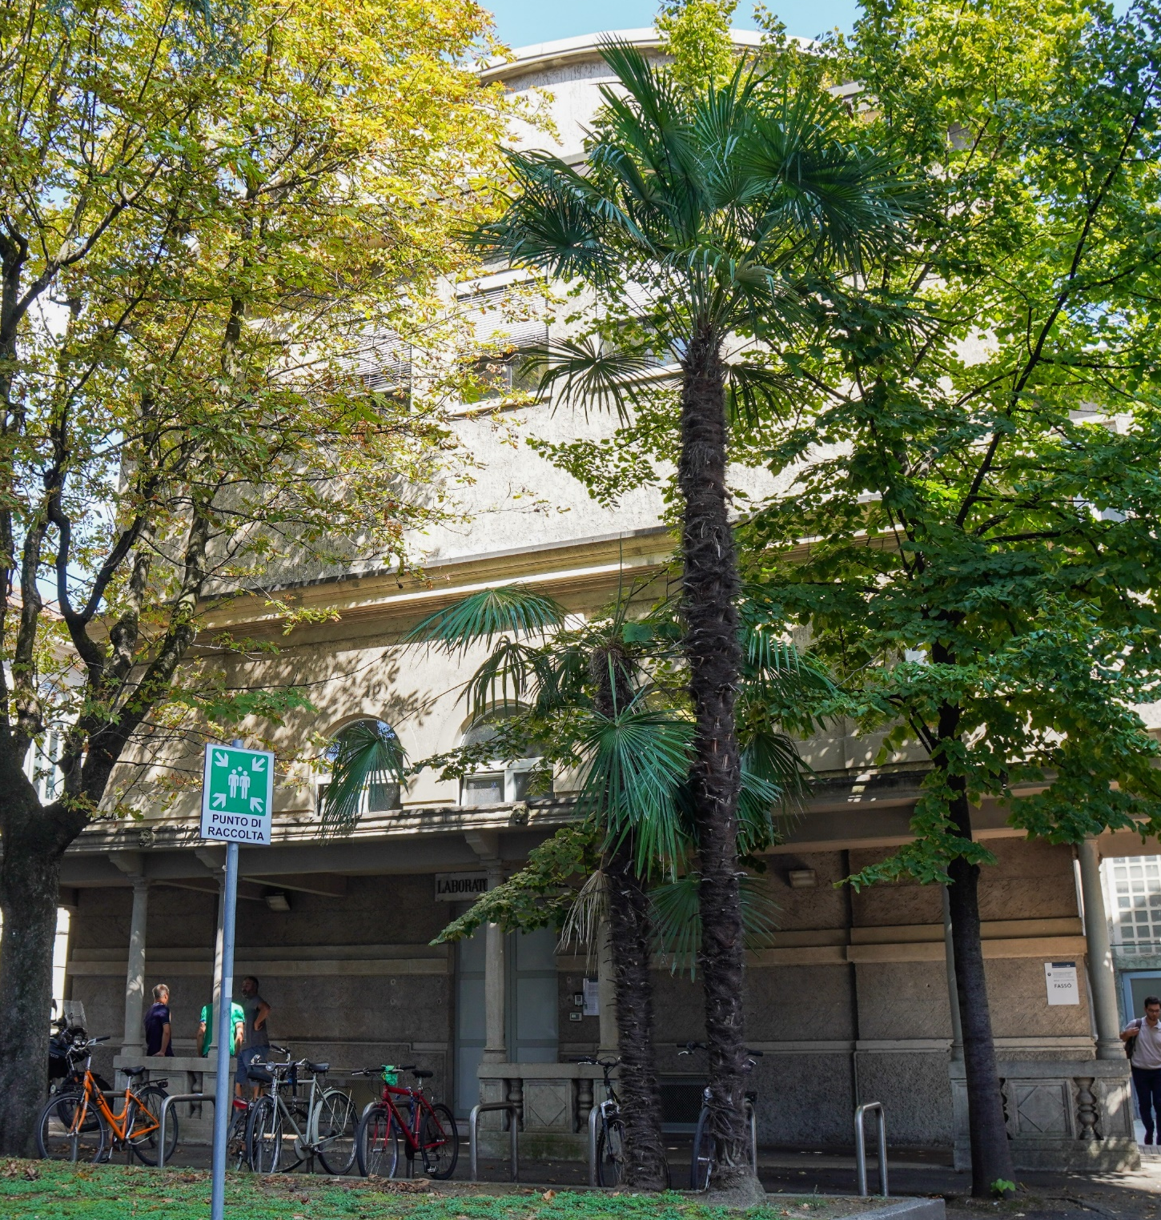

Building 4A
Building 4

Slide 6
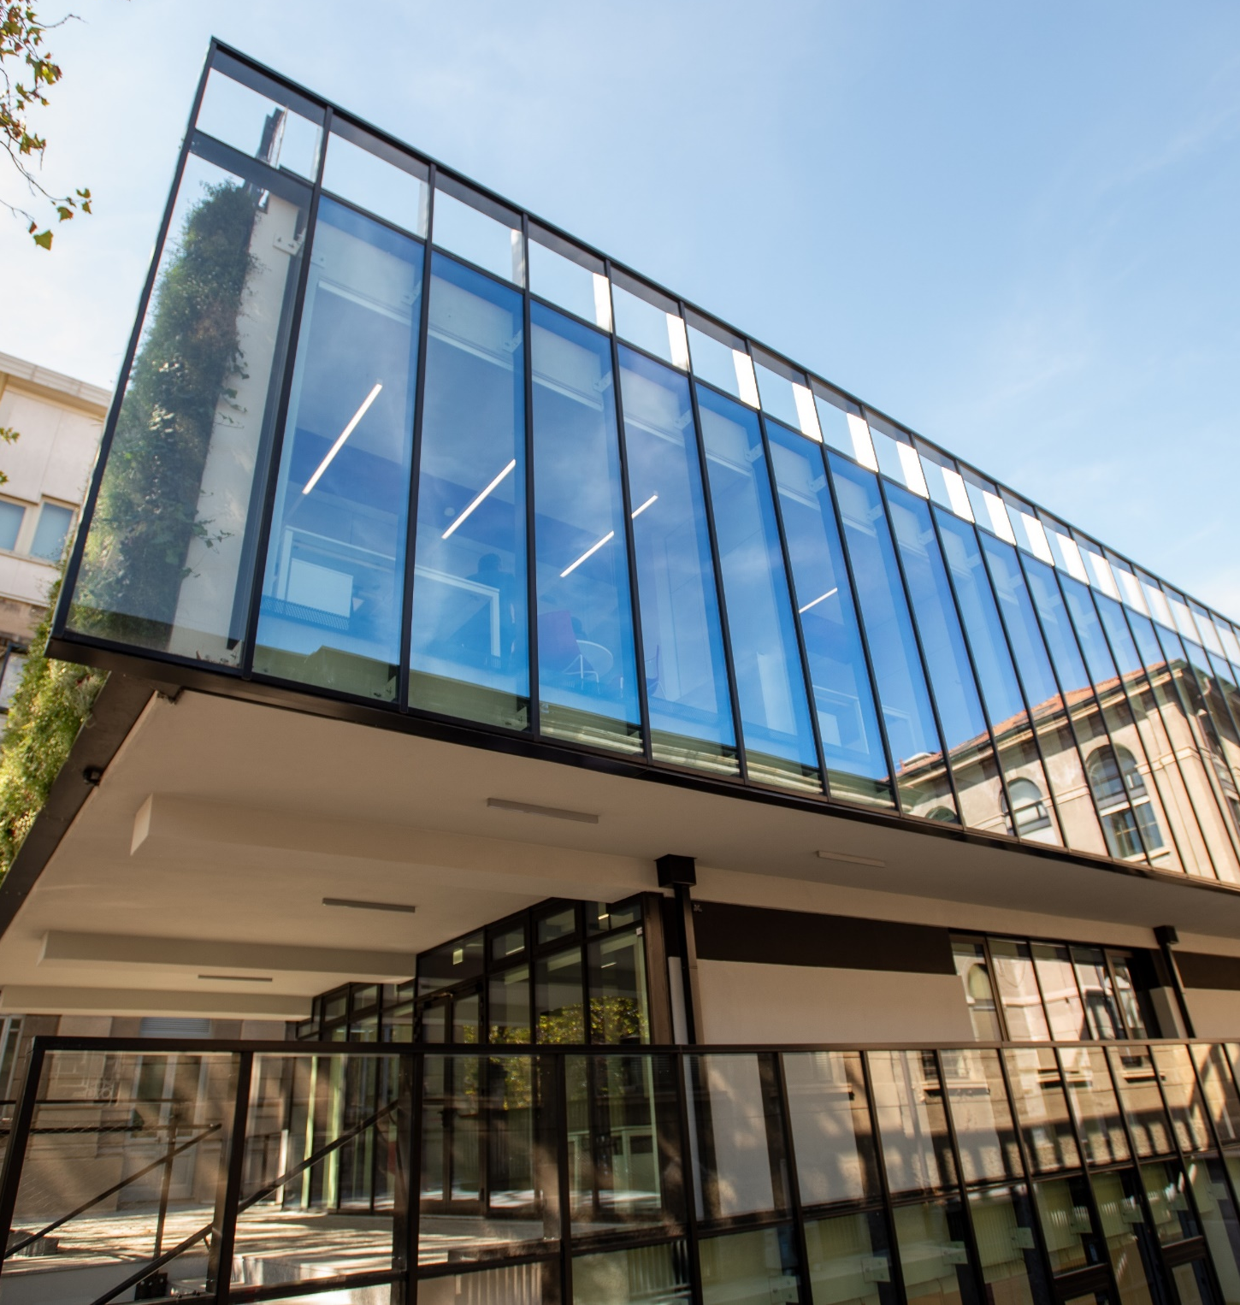

Building 4A
Building 3A
Building 4

Slide 7
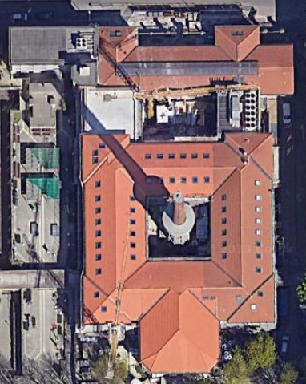
4000m²
Building 4A
Building 4

Slide 8
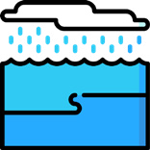

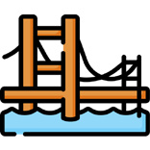




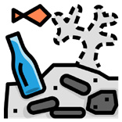
THEMATIC DIVISIONS
WATER SCIENCE AND ENGINEERING
HYDRAULIC ENGINEERING
STRUCTURES AND ENVIRONMENT
CIVIL AND
ENVIRONMENTAL
ENGINEERING
MECHANICS OF MATERIALS AND STRUCTURES
TRANSPORT INFRASTRUCTURES AND GEOSCIENCES
GEODESY AND GEOMATICS
STRUCTURAL DESIGN, DIAGNOSTICS AND REHABILITATION
ENVIRONMENTAL ENGINEERING

Slide 9
People @DICA

Slide 10

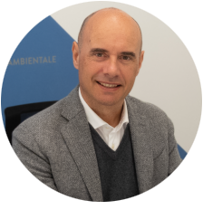
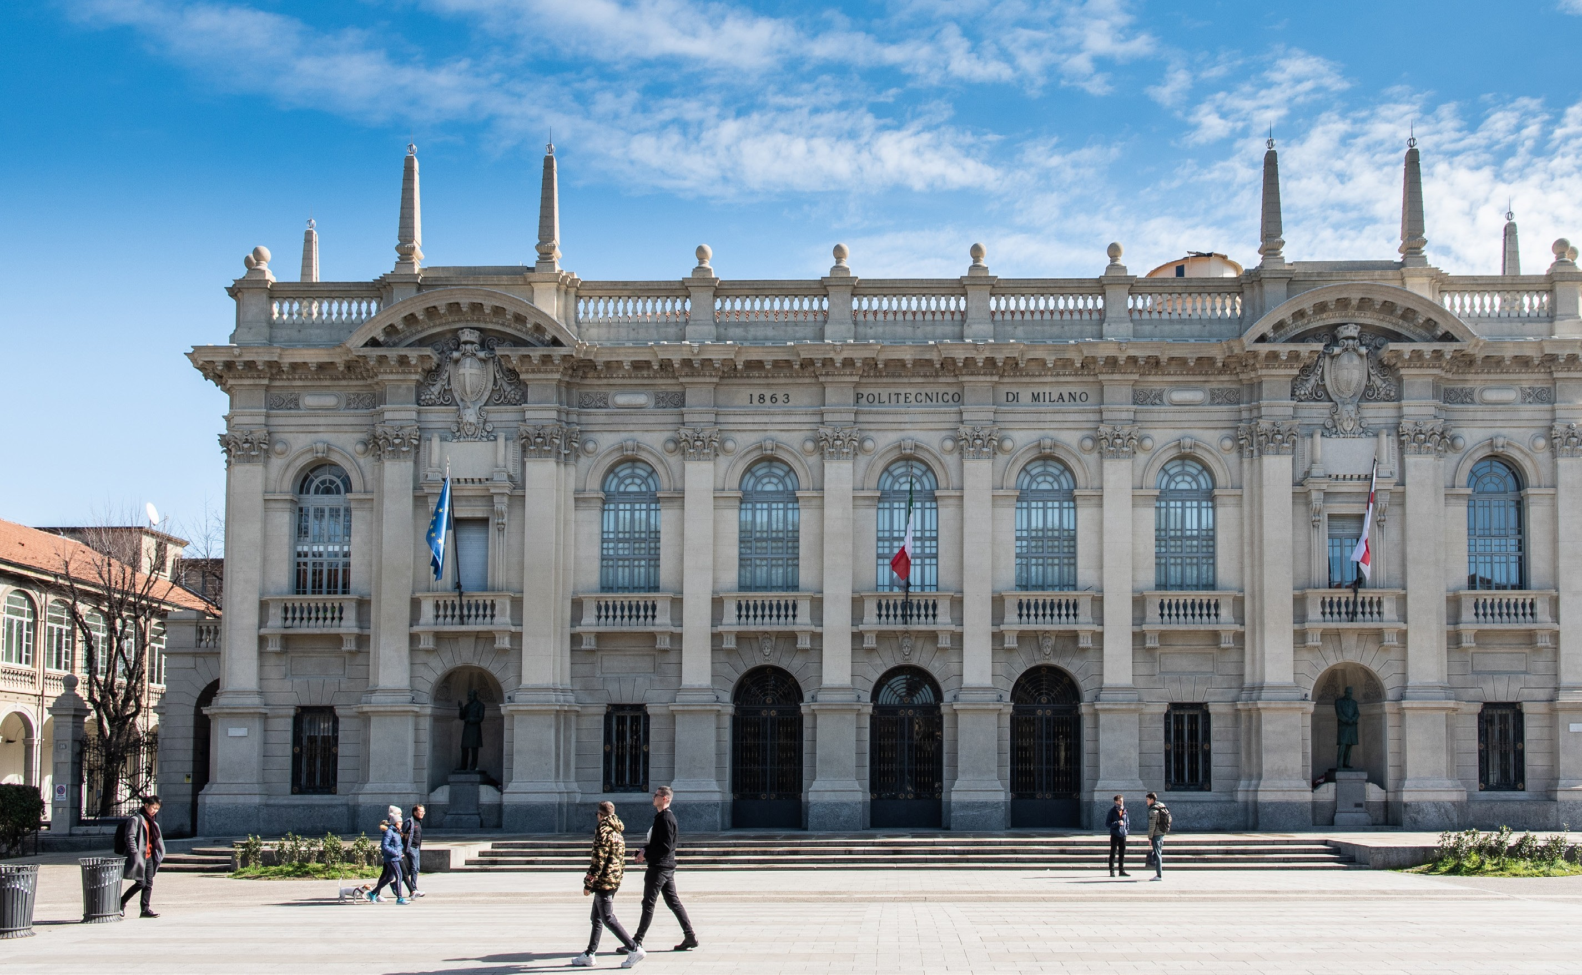
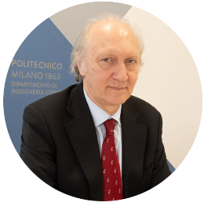
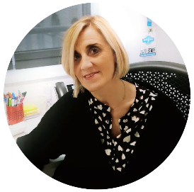





PROF. ATTILIO FRANGI
Department Head
PROF. RICCARDO BARZAGHI
Deputy Head
DOTT.SSA DANIELA FAGNANI
Management Responsible
36% female
representation
125
80
147
39
PROFESSORS
AND RESEARCHERS
January 2022 - 112
RESEARCH
FELLOWS
January 2022 - 80
TECHNICAL
ADMINISTRATIVE STAFF
January 2022 - 39
PhDs
January 2022 - 112

Slide 11
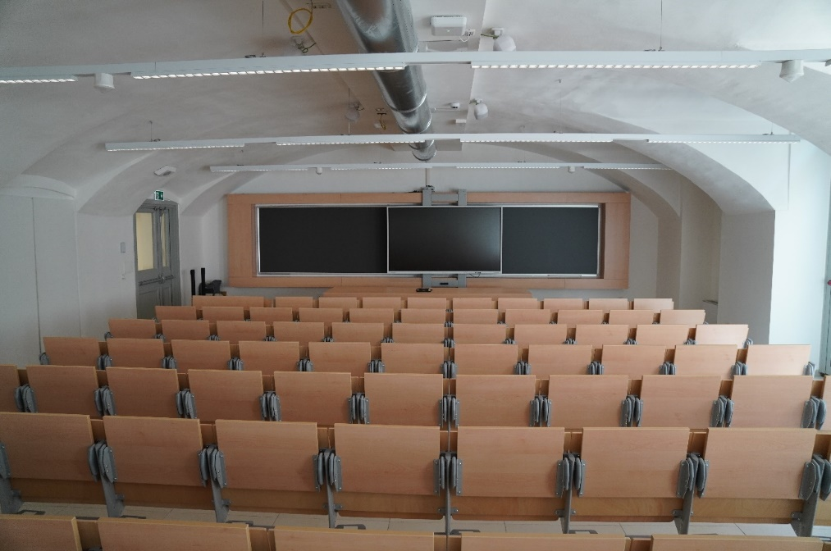
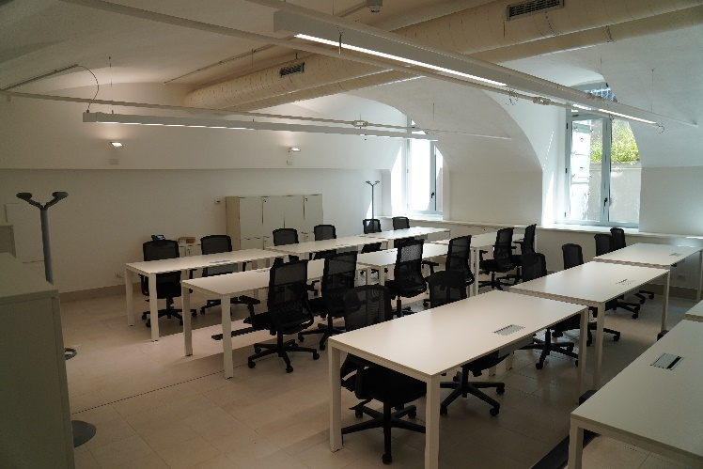
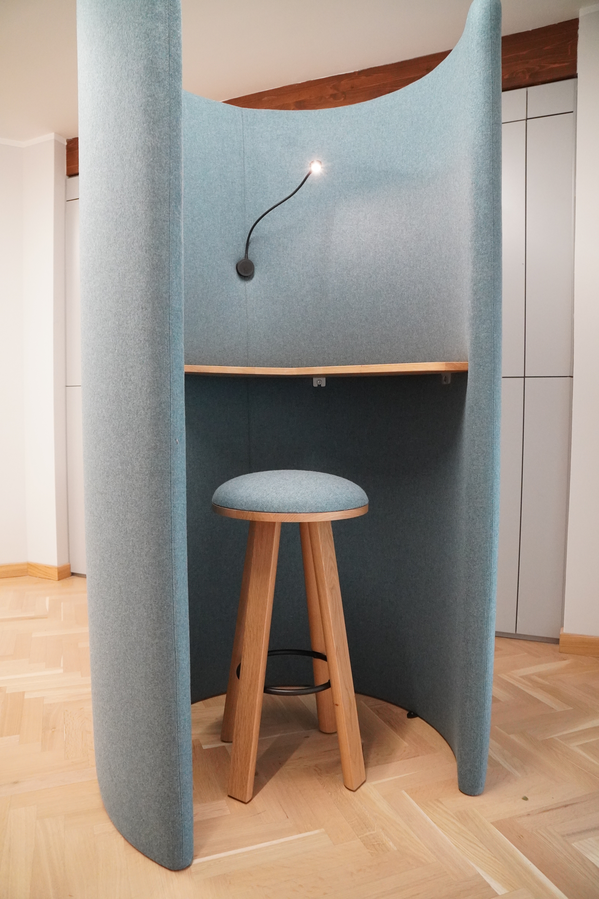
COMMON SPACES FOR WORKING, STUDYING AND SOCIALISING
Grandori Room
Telco Cabins
PhD common spaces

Slide 12
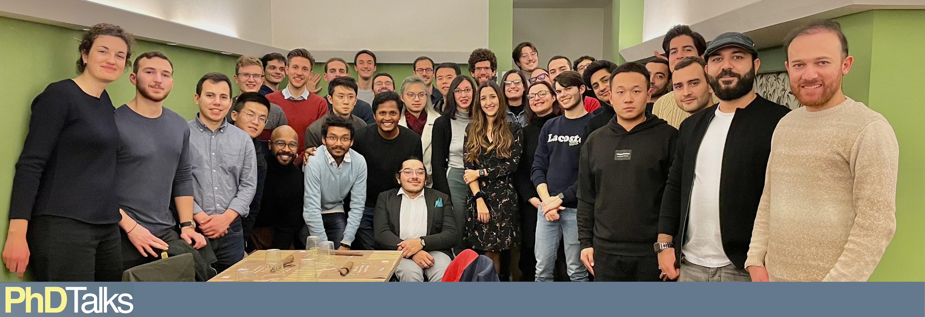
INCLUSIVE ENVIRONMENT - PhDTalks

Slide 13
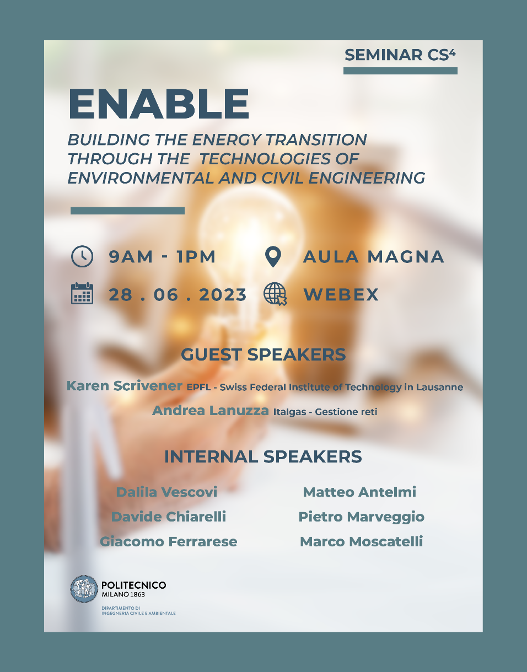
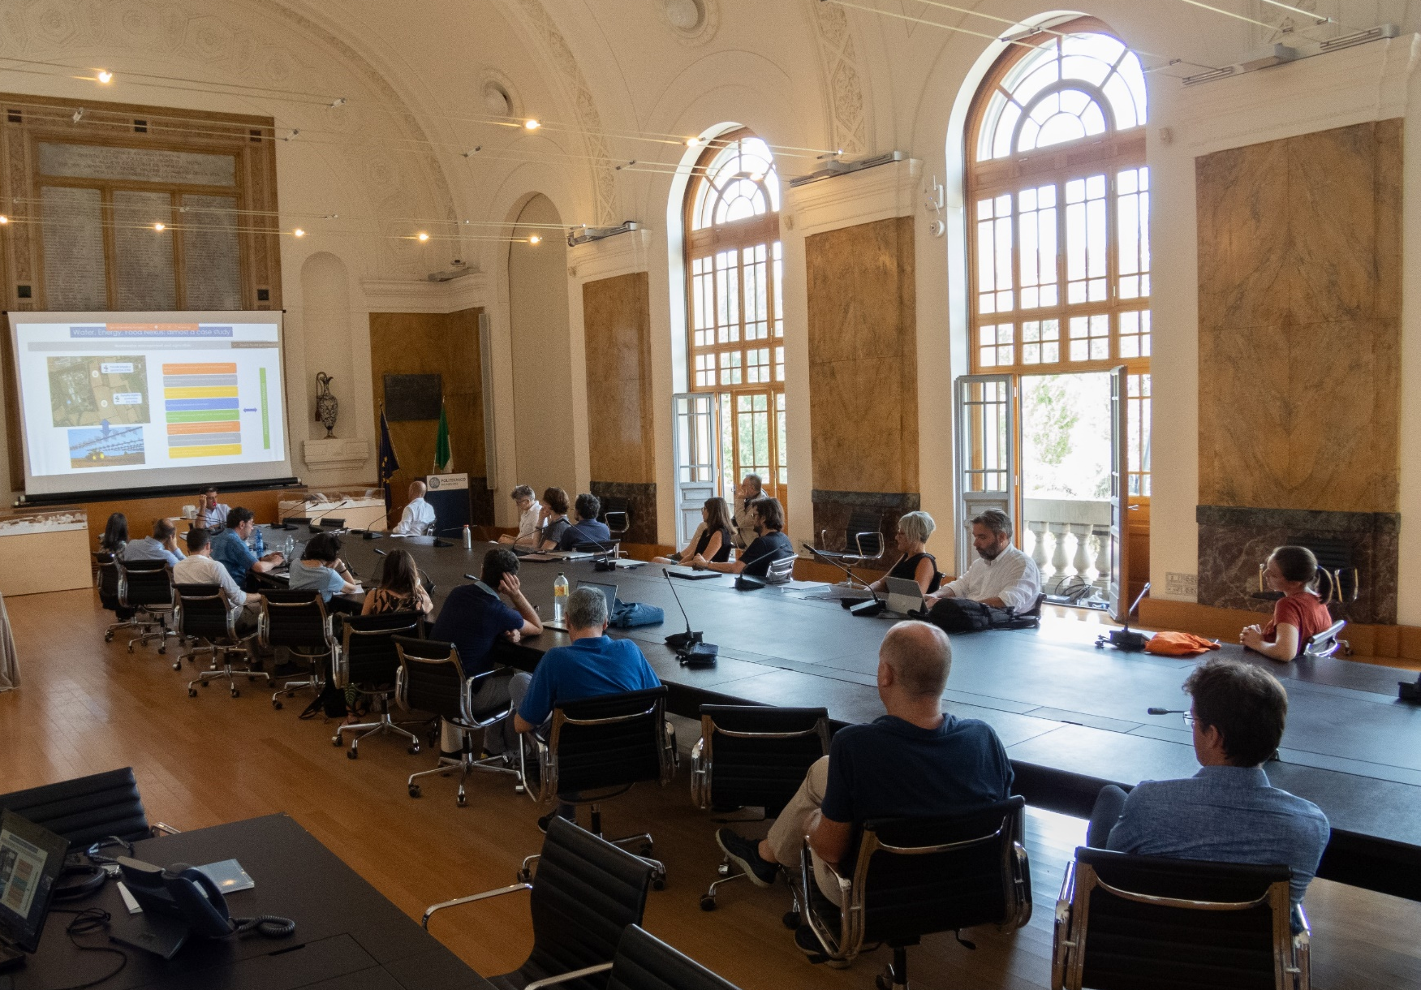
INCLUSIVE ENVIRONMENT –CS⁴ Seminar

Slide 14

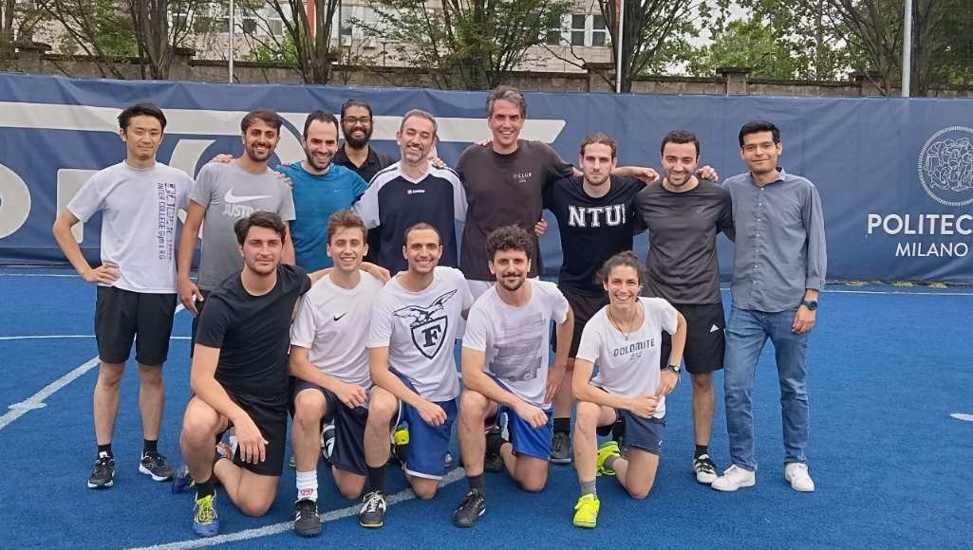
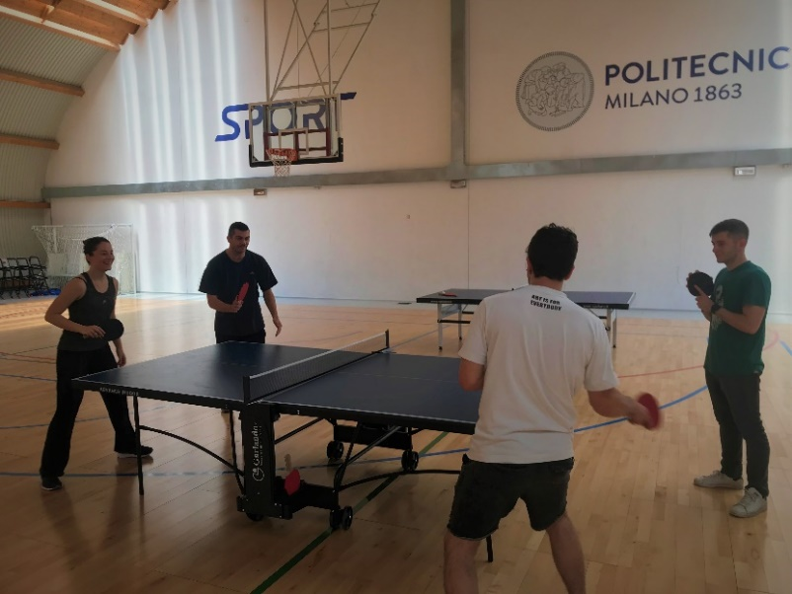
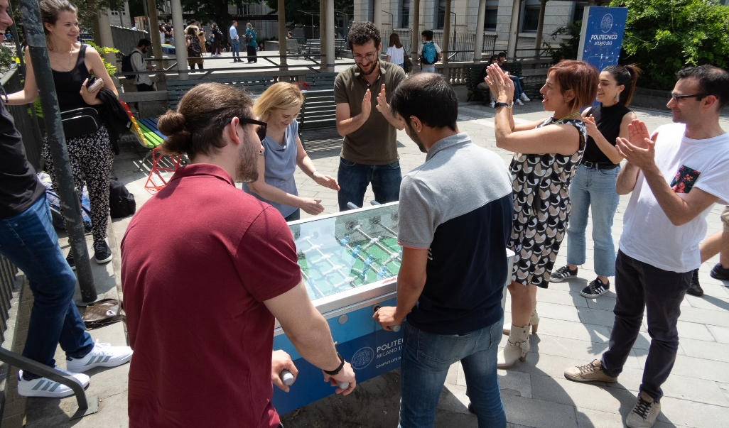
INCLUSIVE ENVIRONMENT – DICA Olympic Games

Slide 15
Teaching @DICA

Slide 16
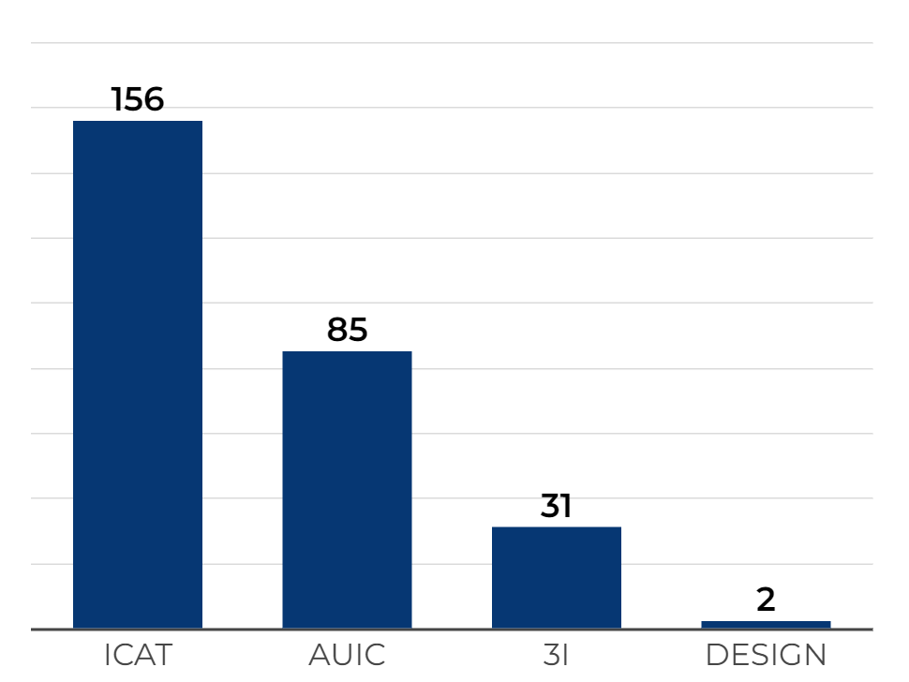
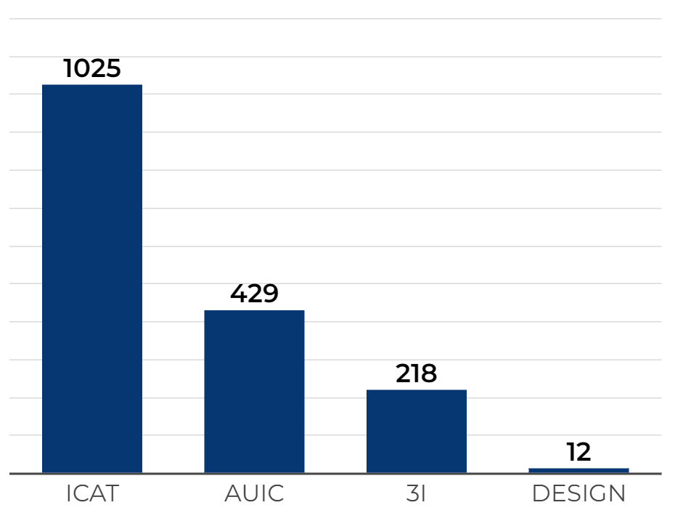
COURSES OFFERED
COURSES – 274 TOTAL
CFU – 1684 TOTAL
transversality of disciplines
major focus on ICAT and AUIC
Strongly supporting ICAT to maximise the appeal of Civil and Environmental Engineering and favour the enrollment of new students

Slide 17
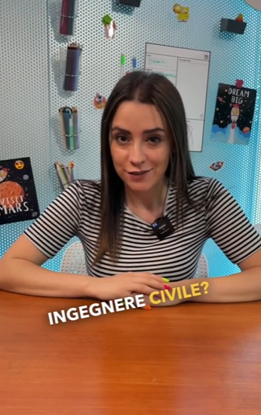
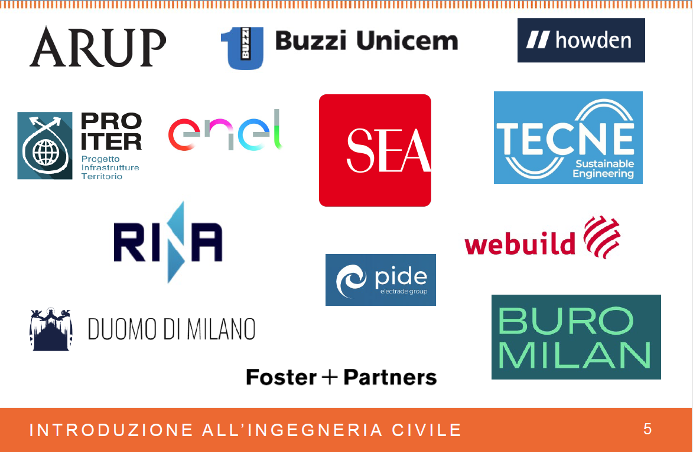

JOINT ACTIONS FOR COMMUNICATION AND INNOVATION
Script TikTok Pills – Skuola.net
targeting high school students
new courses favoring participation of companies and professionals

Slide 18
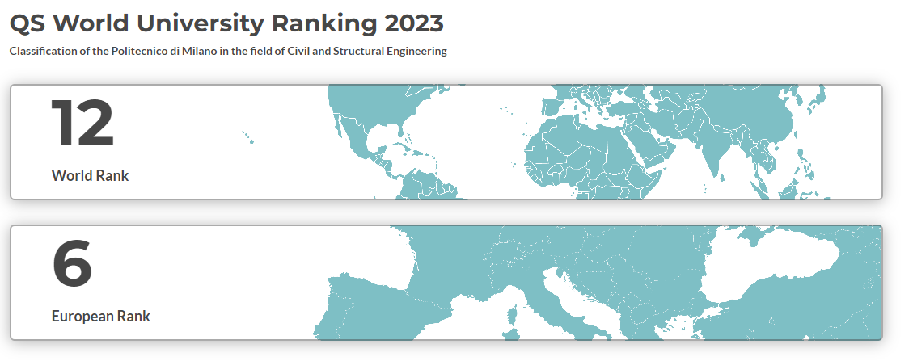
Civil and Structural Engineering @Polimi
Research @DICA

Slide 19
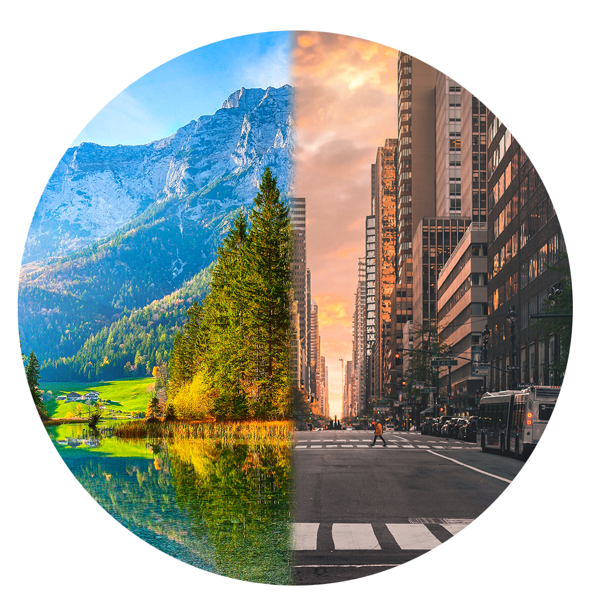
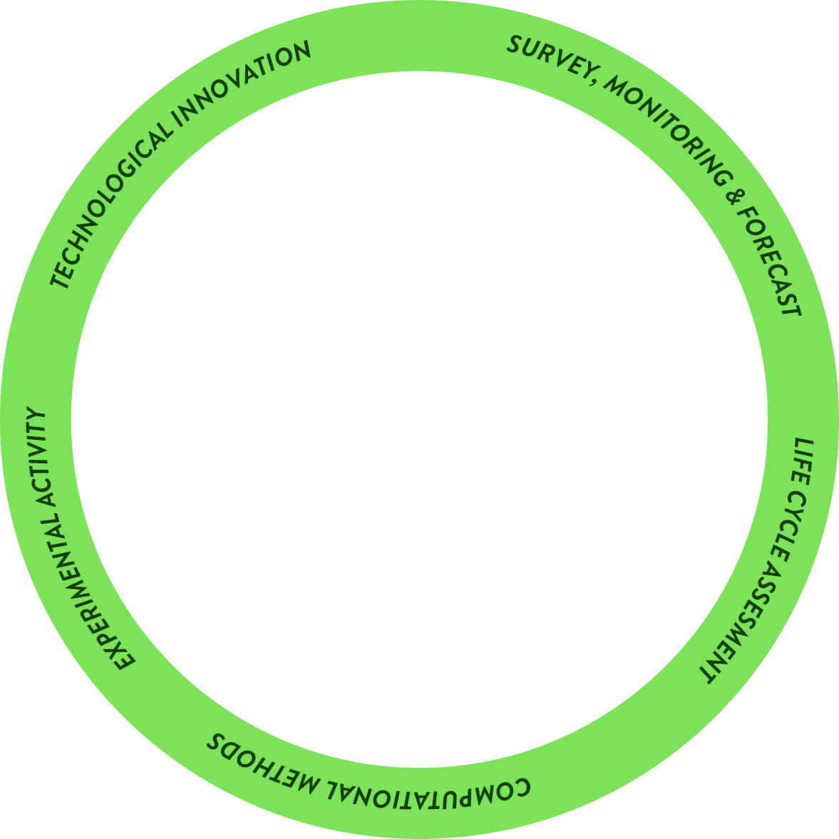
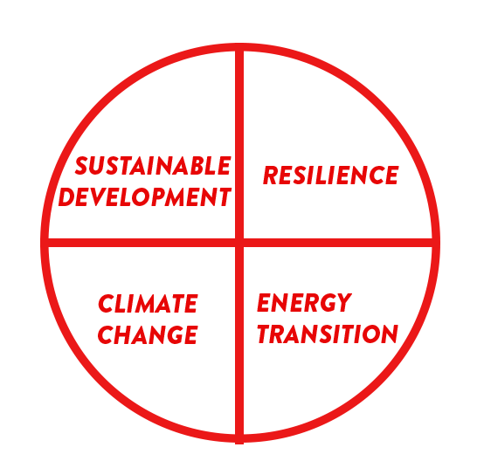
landslides
drought
earthquakes
sensors
buildings
SMART CITIES
NATURAL RISKS
digital twins
EWS
floods
BIM
fire & blast
Citizen Science
recycling & reuse
FOOD
WASTE MANAGEMENT
Agriculture 4.0
remediation
durability & performance
hydrogen storage
POLLUTION
ADVANCED MATERIALS
carbon capture
toughness
3D printing
structural & energy retrofitting
smart functionalities
GNSS
CULTURAL HERITAGE
GIS
EARTH OBSERVATION
bridges
UAV
tunnels & underground structures
resources
energy harvesting
groundwater
dams
WATER
INFRASTRUCTURES
renewable energy
offshore structures
water networks
reservoirs
roads & airports

Slide 20
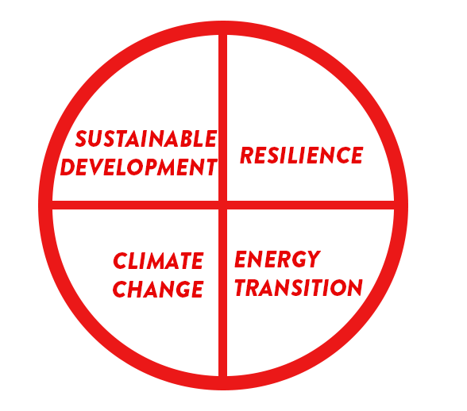
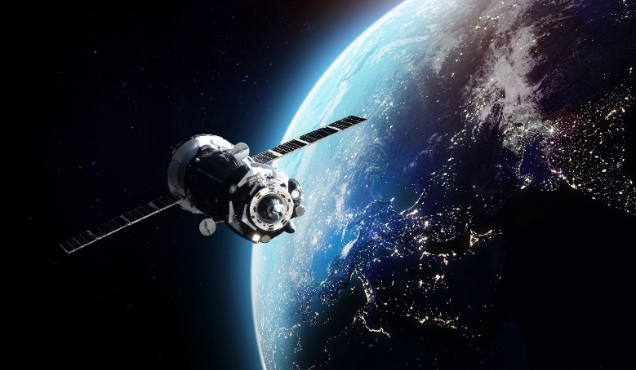
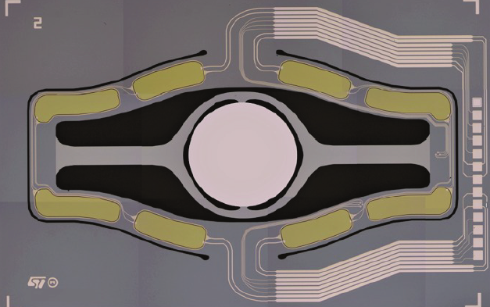
landslides
drought
earthquakes
sensors
buildings
SMART CITIES
NATURAL RISKS
digital twins
EWS
floods
BIM
fire & blast
Citizen Science
recycling & reuse
FOOD
WASTE MANAGEMENT
Agriculture 4.0
remediation
durability & performace
hydrogen storage
POLLUTION
ADVANCED MATERIALS
carbon capture
toughness
3D printing
structural & energy retrofitting
smart functionalities
500 μm
CULTURAL HERITAGE
GIS
EARTH OBSERVATION
bridges
GNSS
UAV
MICROSYSTEMS
mirror for augmented reality
EARTH OBSERVATION
tunnels & underground structures
resources
energy harvesting
groundwater
dams
WATER
INFRASTRUCTURES
renewable energy
offshore structures
water networks
reservoirs
roads & airports

Slide 21
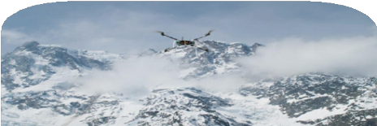
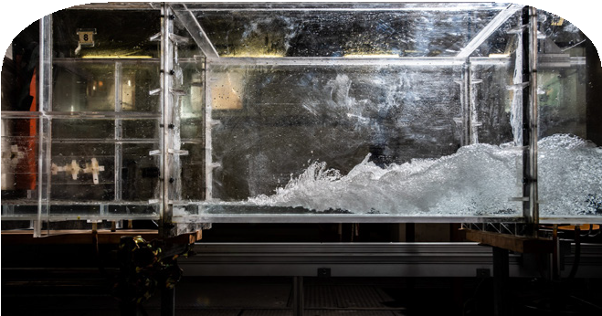
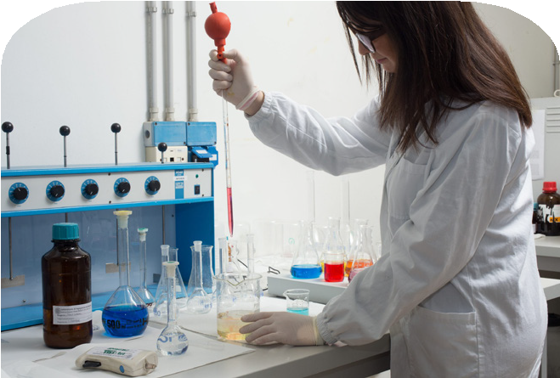
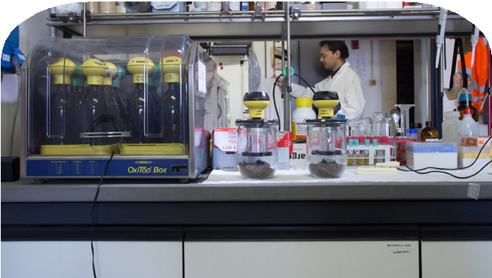
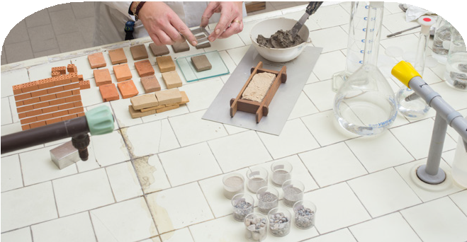
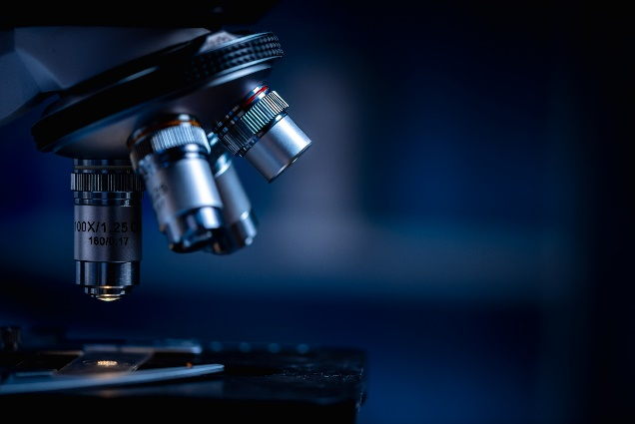
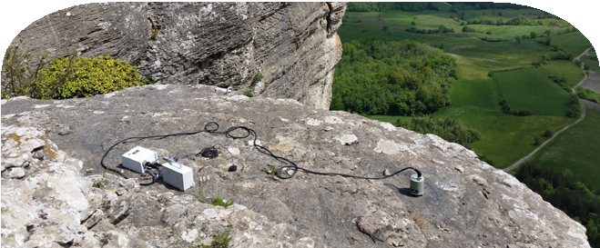
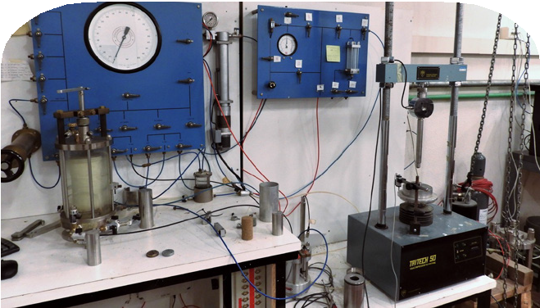
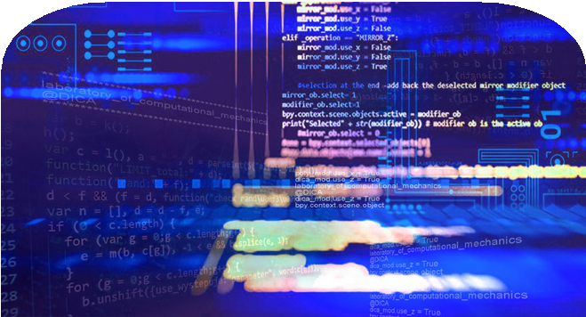
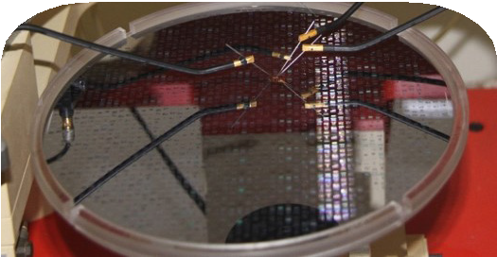
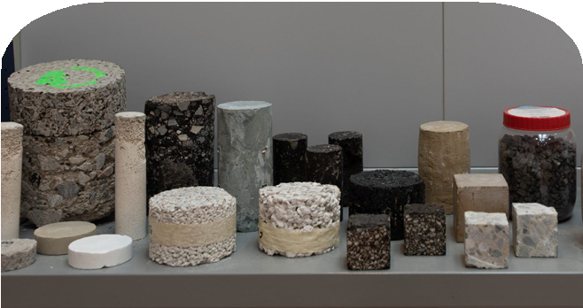
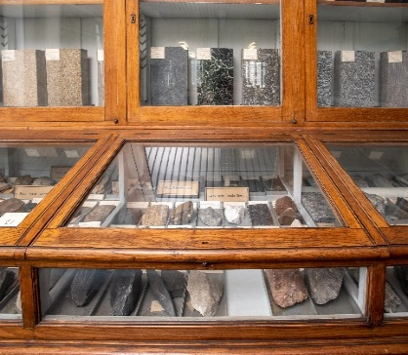
LABORATORY FACILITIES
new!
GEODETIC AND PHOTOGRAMMETRIC MEASUREMENTS LABORATORY (LABMGF)
HYDRAULICS LABORATORY “GAUDENZIO FANTOLI” (LIF)
ENVIRONMENTAL ENGINEERING LABORATORIES
(LIA lab)
ENVIRONMENTAL ENGINEERING LABORATORIES
(FabE-lab)
DIAGNOSTIC AND INVESTIGATION LABORATORY ON BUILDING MATERIALS
SOLID-LIQUID INTERFACE NANOMICROSCOPY & SPECTROSCOPY LAB
(SOLINANO-Σ LAB)
new!
new!
new!
GEOTECHNICAL MATERIALS, PROCESSES AND MODELS LABORATORY
LABORATORY OF COMPUTATIONAL MECHANICS
(LabMecC)
LABORATORY OF MEMS, MICROMECHANICS AND FULL FIELD MEASUREMENTS
(M3 LAB)
RESEARCH LABORATORY ON TRANSPORTATION INFRASTRUCTURES (INFRALAB)
LABORATORY OF APPLIED GEOPHYSICS MEASUREMENTS
PETROGRAPHIC COLLECTION
new!

Slide 22
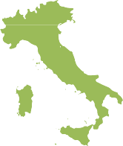
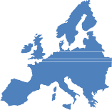









RESEARCH PROJECTS
(2016-2022)
19,3€ M
TOTAL FUNDING
National projects
Some examples:
20
H2020-HE
Other EU projects
Interreg projects
International
projects
15
131
6
2

Slide 23






PNRR – PIANO NAZIONALE DI RIPRESA E RESILIENZA
Centri Nazionali
Ecosistemi per l’Innovazione
DIAGNOSTIC AND INVESTIGATION LABORATORY ON BUILDING MATERIALS
ECOSISTER
Partenariati Estesi+ Bando ASI
PE3 – RETURN: prof. Alberto Guadagnini (environmental, natural and antropogenic risks)
Spoke VS1: prof. Francesco Ballio
2023 – Attilio Frangi, Department Head

Slide 24


RESEARCH CONTRACTS
(2016-2022)
30,6€ M
TOTAL FUNDING
JRP
other
73 research actuating contracts
18 PhD grants
within 17 JRP (Joint Research Platforms) in 2020-23
OUR PARTNERS

Slide 25

PhD PROGRAMS
DEPARTMENT OF CIVIL AND ENVIRONMENTAL ENGINEERING
(IAI – 82 PhDs)
ENVIRONMENTAL AND
INFRASTRUCTURE ENGINEERING
(ISSG – 65 PhDs)
STRUCTURAL, SEISMIC AND GEOTECHNICAL ENGINEERING
147
34% female
representation
PhDs
January 2022 - 112
33%
international PhDs

Slide 26
Social Responsibility @DICA

Slide 27




INVOLVEMENT IN POLIMI PROJECTS
Polisocial

Slide 28




DISSEMINATION and SUSTAINABILITY
In 10 years more than 300 dissemination activities
Popular books and volumes for schools
Informative blogs
Concerts, theatrical performances, film festivals, sporting events, exhibitions, displays and other public utility events open to the community

Slide 29





SCIENTIFIC DISSEMINATION
Organization of workshops and conferences
dedicated journals
continuing education

Slide 30




Born in 2017, the DICA4Schools project is a technical-scientific dissemination tool in schools, through the free offer of interactive laboratories and seminars
workshops held in the spaces of the Politecnico
seminars preferably organized in schools and dealing with topics of interest through open lessons and debates

