Slide 1


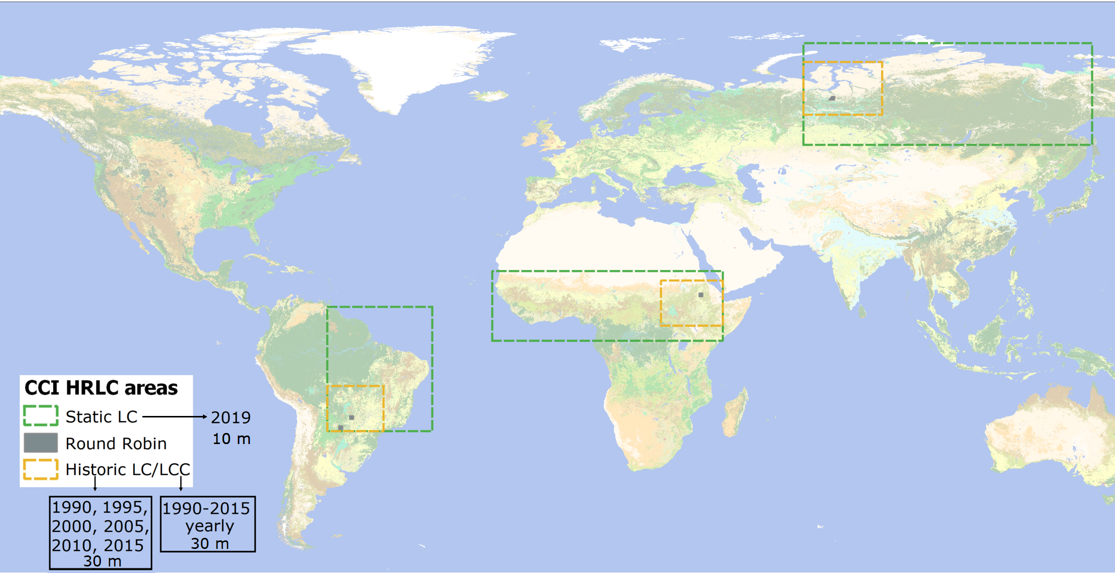
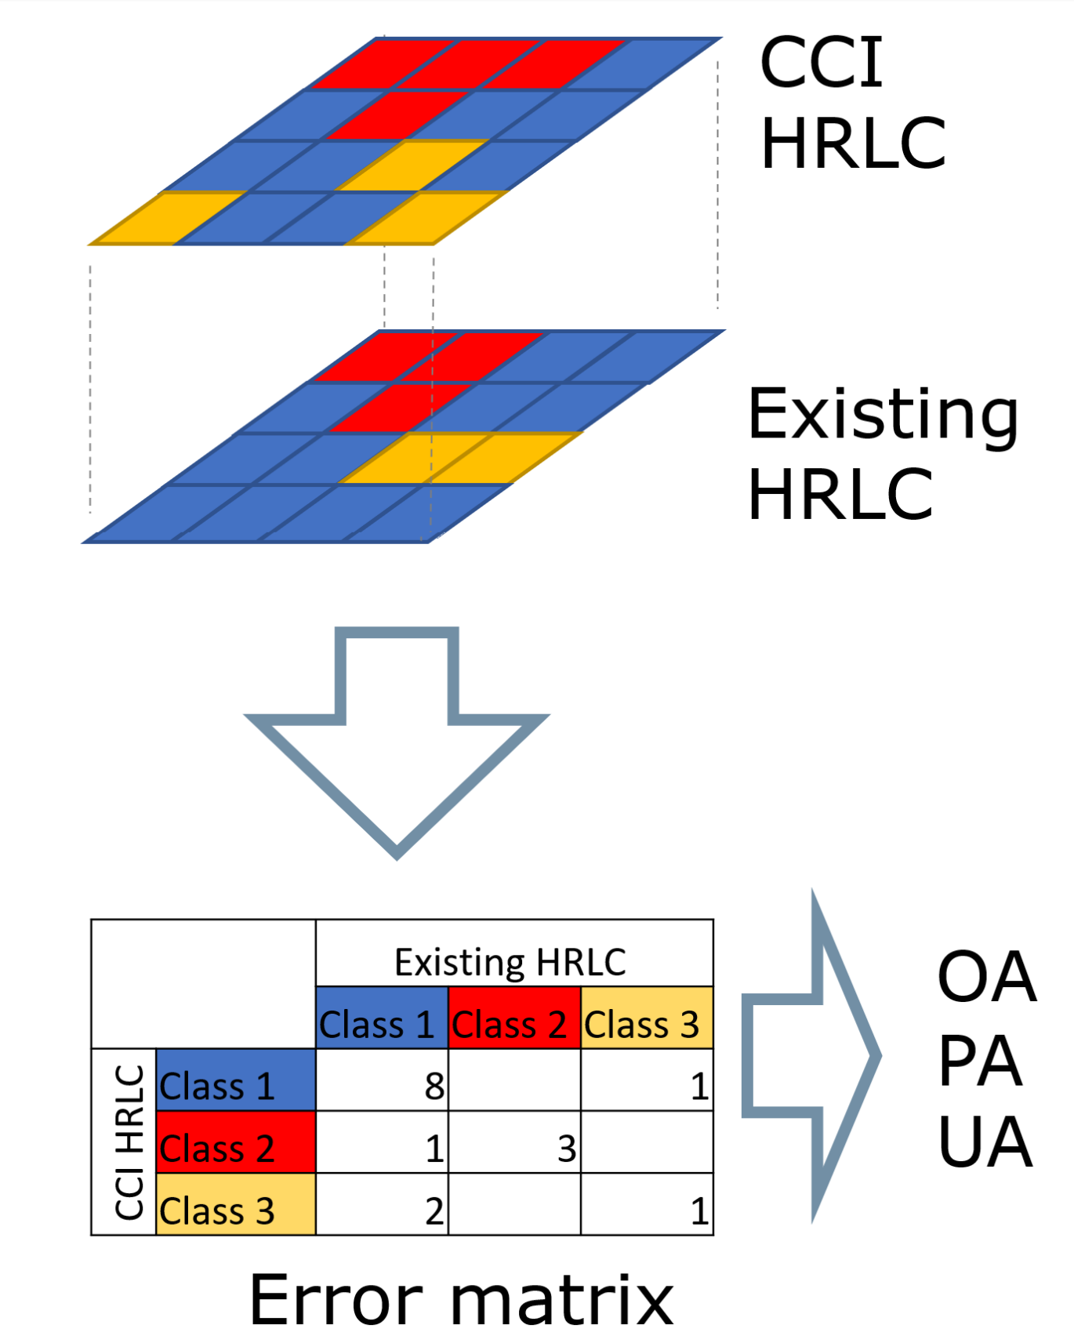
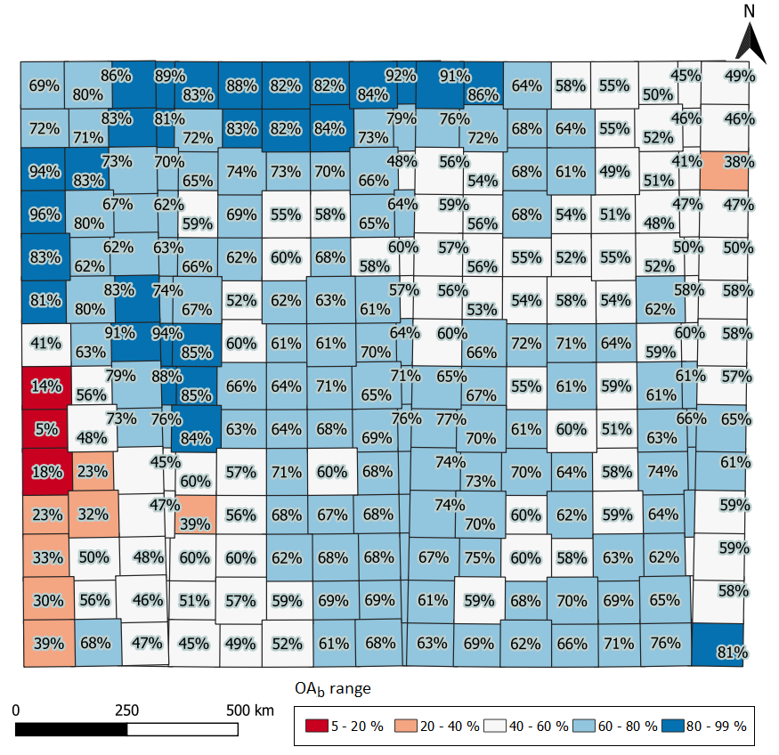
















Inter-comparison for ESA CCI Essential Climate Variables: High Resolution Land Cover
Gorica Bratic
Under supervision of prof. Maria Antonia Brovelli within CCI HRLC project
Project overview
Climate Change Initiative High-Resolution Land Cover (CCI HRLC) is part of the European Space Agency (ESA) Climate Change Initiative (CCI) program. CCI program aims at ensuring the contribution of ESA missions to the Essential Climate Variables (ECV). Since the land cover is one of the ECVs, the CCI HRLC project is dedicated to determining the role of the spatial resolution of land cover (LC) and land cover change (LCC) to support climate research.
The project is carried out through cooperation between climate modelers, Earth Observation communities and industrial partners. It is focused on three macro-regions of the world that are subject to extreme weather conditions and substantial climate change. CCI HRLC consists of two phases. In the first phase LC products are generated for determining their suitability and for tuning climate models, while second phase is final phase where improved version of products will be derived based on lessons-learned in the first phase. A work presented here one of the tasks of the validation team of the project.
CCI HRLC regions
Inter-comparison tasks
The task of the inter-comparison is to compare LC from CCI HRLC project with existing binary and multi-class high-resolution LC (30 m resolution or better) to obtain benchmark accuracy information.
Inter-comparison means comparing pixel-by pixel CCI HRLC outputs with existing HRLC, and computing error matrix and associated accuracy indexes Overall accuracy (OA), Producer’s accuracy (PA) and User’s accuracy. The accuracy indexes have a role of comparative metrics.
Figure 1 - CCI HRLC climate regions defined in the project.
Inter-comparison tasks and challenges
Example of overall results
Preparation for inter comparison includes:
Collecting and storing existing LC
Developing procedure for inter-comparison taking into account:
  Difference in tiling system between project LC and existing LC
  Difference in legend between project LC and existing LC
  Difference in extent between project LC and existing LC
  Difference in CRS between project LC and existing LC
  Big amount of data to store and process → ~100 GB unprocessed LC data (CCI HRLC products and existing LC) + ~100 GB of processed LC data and results
  3 accuracy indexes → Numerous results
Existing dataset | OA_{b}
FROM-GLC | 62%
GL30 | 48%
MapBiomas | 62%
Table 1 – Overall results for Amazon based on 3 existing non-binary datasets.
Inter-comparison methodology and tools
Harmonize existing LC data with CCI HRLC data:
Reproject all datasets in the WGS84 CRS
Match spatially corresponding tiles
Find link between the legends of existing data with the legend of CCI HRLC and adapt classes accordingly
Perform comparison by means of accuracy indexes: Overall Accuracy (OA), Producer’s accuracy(PA), and User’s accuracy(UA)
Figure 3 - Results of OA for each tile of CCI static map in Amazon with respect to FROM GLC
.
Figure 2 – Tools used for the inter-comparison.
Example of per-class results
Ongoing work
Dataset | Index | Bareland | Built-up | Cropland | Forest | Grassland | Shrubland | Water | Water permanent | Water seasonal | Wetland | Wetland Herbaceous | Wetland Shrubby
FROM GLC | PA | 53% | 53% | 68% | 91% | 54% | 19% | 80% |  |  | 55%
GL30 |  | 14% | 43% | 34% | 88% | 43% | 17% | 75% |  |  | 17%
MapBiomas |  | 36% | 59% | 65% | 88% | 59% | 21% | 74% |  |  |  | 40% | 0%
FNF |  |  |  |  | 84% |  |  | 26%
GHS BU S1 |  |  | 59% |  |  |  |  |  | 87% | 12%
GSW seasonality |  |  |  |  |  |  |  |  | 83% | 15%
GSW v1 2
FROM GLC | UA | 0% | 36% | 67% | 69% | 74% | 25% | 67% |  |  | 19%
GL30 |  | 0% | 38% | 90% | 65% | 15% | 22% | 67% |  |  | 38%
MapBiomas |  | 3% | 48% | 69% | 67% | 79% | 20% | 76% |  |  |  | 27% | 0%
FNF |  |  |  |  | 68% |  |  | 52%
GHS BU S1 |  |  | 26%
GSW seasonality |  |  |  |  |  |  |  |  | 76% | 12%
GSW v1 2 |  |  |  |  |  |  |  |  | 74% | 21%
Compare all existing HRLC in an area and extract areas where all the maps are showing the same class. The resulting map is called map of agreement.
The area of agreement takes a value of the class on which all the existing land cover available in that area agree.
Preliminary analyses show that the map of agreement has very high accuracy (above 90%), and therefore it can be valuable source for training and/or testing samples of classification procedure.
Table 2 – Per-class results for whole Amazon based on 3 non-binary and 4 binary existing datasets
Scientific Leader: Lorenzo Bruzzone (lorenzo.bruzzone@unitn.it) Project Manager: Francesca Bovolo (bovolo@fbk.eu) ESA technical officer: Olivier Arinò (Olivier.arino@esa.int) Website: http://cci.esa.int/HRLandcover

